Slide 1
Redline & Negotiate CONTRACTS LIKE A PRO
ACC Annual Conference
Speakers:
Nada Alnajafi, Founder, Contract Nerds & Sr. Corporate Counsel, Franklin Templeton
Megan Fouty, General Counsel & CHRO, Glowforge
Justin Schweisberger, CRO, Pramata
Notes:
Contract Nerds is a blog, resource, and community all about contracts. I established Contract Nerds almost three years ago. In the middle of the pandemic, I started posting contract negotiation tips on LinkedIn. Then I created the Contract Nerds website and started inviting experts to contribute articles. We’ve now published over 180 articles about contracts, on topics like contract drafting, contract negotiation, contract management, technology agreements, data privacy agreements, and more.
Our mission is to improve the way we learn about contracts through quality content and community. To accomplish this goal, we provide relevant and accessible resources about contracts via our website, newsletter, webinars, and social media platforms.
We publish content from various contract experts around the world, not just one person. We believe that diversity of thought, background, and experience is an important part of learning how to contract in the real world. The cool thing about our content is that we don’t pay for it and it is offered on an invite-only basis.
We welcome all types of lawyers and contracts professionals who work with contracts. This includes general counsel and in-house counsel, supply chain and procurement professionals, sales and legal tech professionals, contract managers and legal ops, paralegals, students, entrepreneurs and more. Don’t think twice about whether you belong here simply because of your job title. If you work with (or want to work with) contracts, you are a part of Contract Nerds!
This is the first event in our brand new webinar program. Every month, we will host a different webinar program that will be led by a different contracts expert. I’ll be the host and we are very thankful that Lexion is our sponsor. Which means we can offer these events and CLE certification to you for free.
With that, I’d like to introduce Jessica Nguyen, the Chief Legal Officer of Lexion. She loves red meat, hoodies, and contracts. Jessica, thanks so much for being here!

Slide 2
TODAY’S EXPERTS
Nada Alnajafi is an award-winning in-house attorney, blogger, author, and the Founder of Contract Nerds. She currently serves as Sr. Corporate Counsel for Franklin Templeton, a Fortune-500 global financial services organization. Previously, she built contracting departments and served as in-house counsel for Faraday Future and Lexus. She has a dynamic legal and consulting background, making her more than just an attorney; she is a trusted advisor, business partner, project manager, creative problem-solver, and skilled negotiator. Nada is particularly passionate about contracts. She dedicates much of her time outside of work to creating resources about contracts for lawyers and contracts professionals, including via her blog Contract Nerds, her book Contract Redlining Etiquette, and her LinkedIn posts. Recognized for the way she is transforming the contracting space, she was recently awarded a Top Ten 30 Something by the Association of Corporate Counsel and Inspiring Woman of 2023 by the World Commerce & Contracting.
Megan Fouty is the General Counsel and CHRO at Glowforge, a Seattle-based technology start-up that designs and produces 3D laser printers. Megan oversees the Legal, HR, customer support, recruiting, and facilities teams. Megan came from heading up the legal team at Convoy, Inc. another Seattle-based technology start up. In addition to her day job, Megan founded and runs Diversity University, a company that provides diversity, equity, and inclusion tools for law firms and organizations. Megan's background includes both law firm and in-house experience with previous senior legal positions at Moss Adams, one of the country's largest public accounting firms and Expeditors International, a Fortune 500 international logistics company. Megan serves on the board of directors for Providence Pediatric Hospice of Seattle. She was awarded a Top Ten 30 Something by the ACC, received the "Legal MVP Award" by SimpleLegal, listed in Marquis 2022 Who's Who in America, featured on the "The Counsel" Podcast, and recognized by Women, Influence and Power in Law for Championing Diversity in-house and for Innovative Leadership. She recently published her book, The Art of Networking.
Justin Schweisberger is one of Pramata’s earliest employees and currently leads their sales, marketing and strategic partnerships. In this role, he sets the company’s global market positioning and forges Pramata’s relationships with some of the world’s top brands. Justin has held a variety of leadership positions during his tenure including overseeing the company’s product and consulting teams, as well as Pramata’s operations in India. Previously, Justin managed M&A due diligence and contract management initiatives for one of the country’s largest law firms. During this time, he most notably guided a $6 billion acquisition of a leader in the metals industry. Justin graduated from Harvard College with a bachelor’s degree in psychology.

Slide 3
AGENDA: 10 TIPS
What can we in-house counsel do to redline and negotiate contracts more efficiently?
Pre-Negotiation (Tips 1-3)
In-Negotiation (Tips 4-8)
Post-Negotiation (Tips 9-10)
Notes:
One of the challenges is that 79% of contracts professionals learn how to redline contract on the job. Not in school or a formal training program. Not in law school, not in a formal training program, and not from a mentor or boss. That means, most of us redline in a different way and each of us think we’re doing it the right way.
This lack of uniformity within the redlining process creates many problems across the overall contracting lifecycle. Like too many back and forth emails, disruptions to the natural flow of the negotiation, and a lack of clarity to the overall contract negotiation process. It also slows down the rate at which contracts professionals learn how to master contracts. I estimate that it usually takes someone who works with contracts about 10 to 15 years to see themselves as a contracts experts, which is about as long as it takes to become a surgeon.
So here is this skill that we all use every single day, but we each learned how to do it a different way, and many of us are still learning, practicing, testing our skills out while on the job. Like testing out new features in production mode. That can be scary, right?
So here’s the question that I’m going to answer for you today. How can we build both the skills and the confidence needed to successfully redline and negotiate complex clauses? In this presentation, my co-presenters and I are going to share ten power tips that will help you better prepare for the live negotiation and set you up for success the next time you’re discussing a complex clause.
My goal by the end of this presentation is that you’ll have actionable tips you can apply to your work today and that you’ll feel more empowered to engage in a live negotiation. Because the best way to reach agreement on a complex clause is to talk about it live with the other party. So how can we get there and succeed?
[POLL #2 – Have you ever taken a course on negotiation skills? A) Yes B) No]

Slide 4
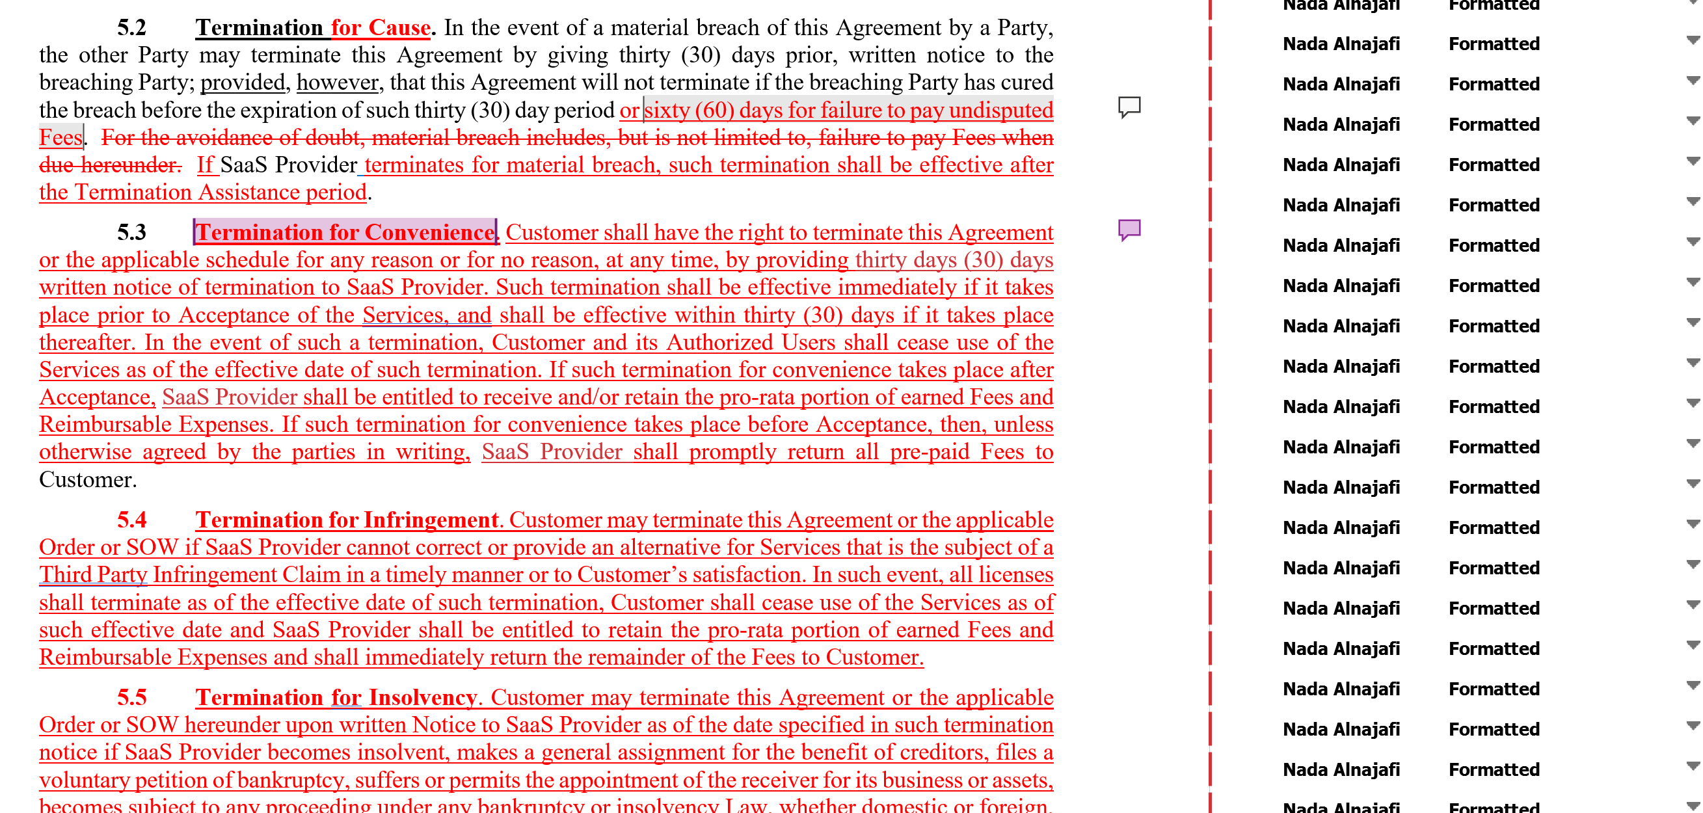
HOW DOES THIS MAKE YOU FEEL?

Slide 5
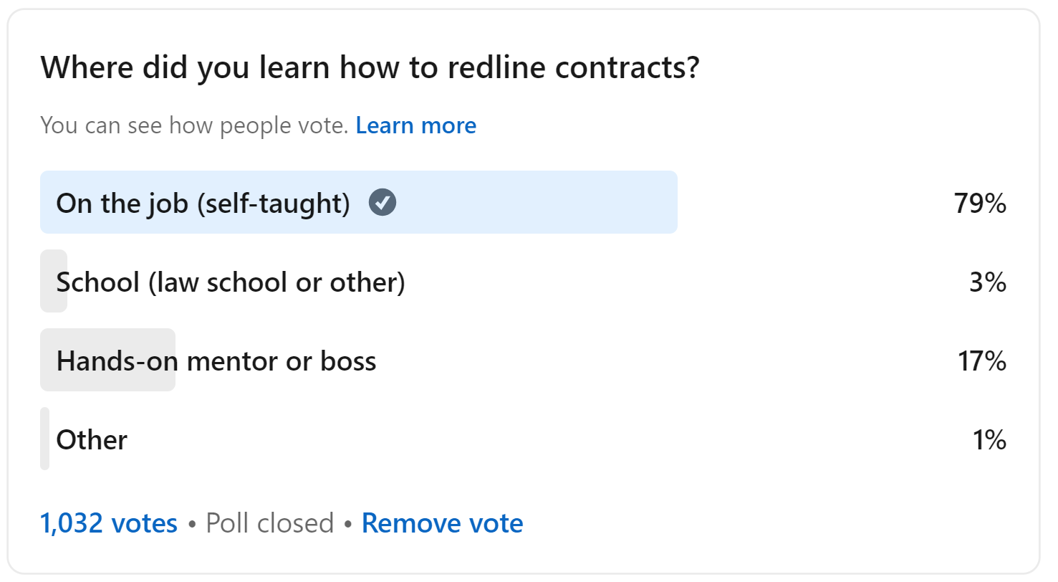
REDLINING SKILLS ARE LARGELY SELF-TAUGHT
Notes:
One of the challenges is that 79% of contracts professionals learn how to redline contract on the job. Not in school or a formal training program. Not in law school, not in a formal training program, and not from a mentor or boss. That means, most of us redline in a different way and each of us think we’re doing it the right way.
This lack of uniformity within the redlining process creates many problems across the overall contracting lifecycle. Like too many back and forth emails, disruptions to the natural flow of the negotiation, and a lack of clarity to the overall contract negotiation process. It also slows down the rate at which contracts professionals learn how to master contracts. I estimate that it usually takes someone who works with contracts about 10 to 15 years to see themselves as a contracts experts, which is about as long as it takes to become a surgeon.
So here is this skill that we all use every single day, but we each learned how to do it a different way, and many of us are still learning, practicing, testing our skills out while on the job. Like testing out new features in production mode. That can be scary, right?
So here’s the question that I’m going to answer for you today. How can we build both the skills and the confidence needed to successfully redline and negotiate complex clauses? In this presentation, my co-presenters and I are going to share ten power tips that will help you better prepare for the live negotiation and set you up for success the next time you’re discussing a complex clause.
My goal by the end of this presentation is that you’ll have actionable tips you can apply to your work today and that you’ll feel more empowered to engage in a live negotiation. Because the best way to reach agreement on a complex clause is to talk about it live with the other party. So how can we get there and succeed?
[POLL #2 – Have you ever taken a course on negotiation skills? A) Yes B) No]

Slide 6
Redlines are more than just markups. They are a powerful negotiation tool.
Notes:
And as contracts professionals we’ve got a special negotiation tool that is reserved only for us. We’ve got the redlines. Redlines are more than just markups. They are our most powerful negotiation tool when it comes to negotiating contracts. And when used to their fullest advantage, they can help us get through the toughest of negotiations.

Slide 7
1
Select the best template for the deal.

Slide 8
YOUR TEMPLATE VS. THIRD PARTY TEMPLATE
Which template starts you out closer to the finish line?
What matters:
What doesn’t matter:
Substantive alignment with the deal
Distribution of obligations and liabilities across the parties
Organization and design
Bargaining power
Title of the template
Who sent their template first
How much time it will save you

Slide 9
YOUR TEMPLATE VS. THIRD PARTY TEMPLATE
How to negotiate the template:
Train your front-line team members
Run a gap analysis
Understand your deal breakers
Create custom templates for your most frequent or important deals

Slide 10
2
Establish the redlining process from the start.

Slide 11
WHAT SHOULD WE EXPECT FROM EACH OTHER?
What is the contract redlining process?
Make sure you’re aligned with:
Your counterparty
Your internal business clients
Your outside counsel

Slide 12
WHAT SHOULD WE EXPECT FROM EACH OTHER?
Sample Redlining Procedures:
Dear [Counterparty],
Please find our Master Services Agreement template attached. Before we begin the redlining and negotiation process, let’s align on expectations. We follow contract redlining best practices in order to ensure clear, efficient, and collaborative redlines.
Contract redlines should be presented as follows:
Reflect all changes to the contract using Track Changes in Microsoft Word.
Leave comments in the margins explaining the reason for substantive changes.
Send the contract back to us in Microsoft Word format without Lock Tracking.
If you agree to a change we propose, you may Accept it.
If you disagree with a change we propose, instead of using the Reject button (which can disappear the redlines) we ask that you backspace the redline instead.

Slide 13
3
Align your redlining style and your negotiation style.

Slide 14
FIVE COMMON NEGOTIATION STYLES
1 | Accommodating
2 | Avoiding
3 | Collaborative (win/win)
4 | Competitive (win/lose)
5 | Compromising
Accepting all redlines right away because you really want this deal to close.
Ignoring markups, questions, comments; deferring the decision to a later time; non-responsive to emails.
Redlines plus explanatory comments with parties working together to find solutions.
Ignoring or removing markups, questions, comments without explanation; not using explanatory comments with redlines; sending redlines in PDF or Lock Tracking.
Offering conditional counterproposals, getting internal approvals to accept certain risks.
Notes:
[POLL #3: What is your go-to negotiation style? 1) Accommodating 2) Avoiding 3) Collaborative 4) Competitive 5) Compromising]
In order to achieve maximum impact, be sure that your negotiation strategy and your redlining strategy are aligned.
Switch between different styles based on the circumstances.

Slide 15
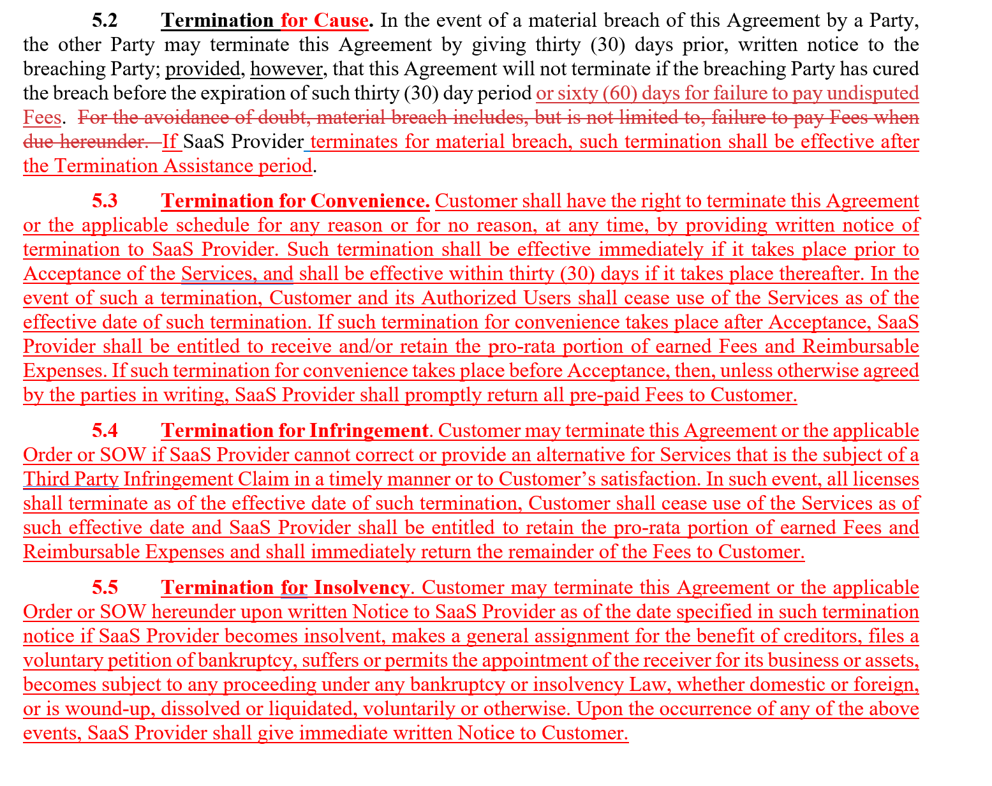
EXAMPLE REDLINES 1
No explanatory comments with redlines
Competitive or Avoiding negotiation style
Notes:
In order to achieve maximum impact, be sure that your negotiation strategy and your redlining strategy are aligned.

Slide 16
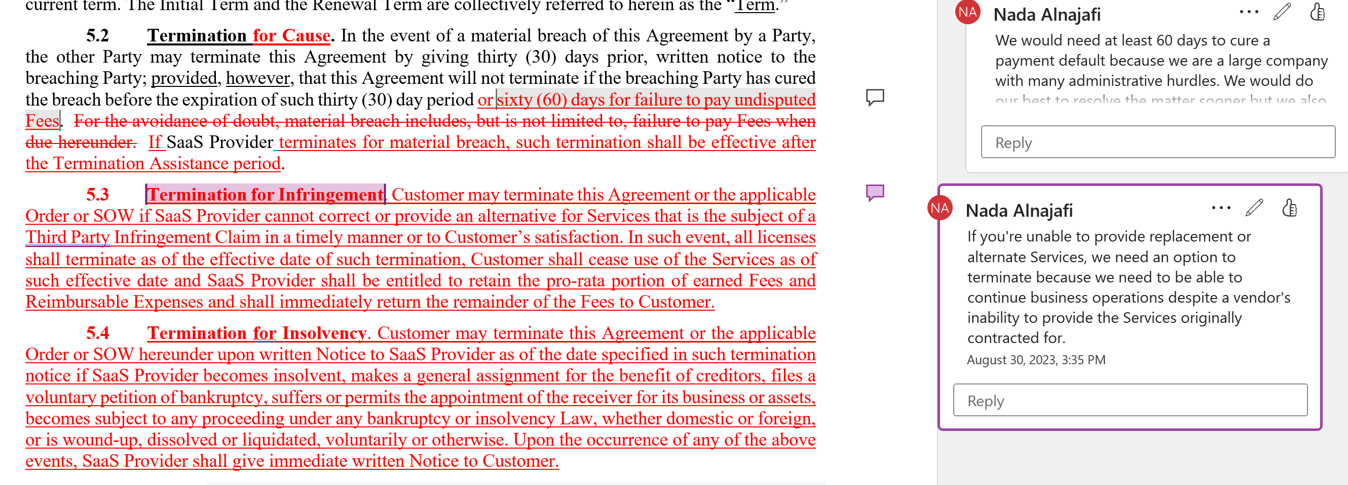
EXAMPLE REDLINES 2
Helpful explanatory comments with redlines
Collaborative or Compromising negotiation style
Stay tuned for Part 2 for a deep dive into comments!
Notes:
.

Slide 17
4
Use explanatory comments with your substantive redlines.

Slide 18
What is the secret power word?
WHAT TO SAY IN THE COMMENTS
Because.
Notes:
What if I told you that there’s a secret power word that you could use to get the other side to agree with your change? [QUESTION: What do you think the secret power word is?]
[Wait for response…]
Studies in social psychology have shown that people resist change unless you give them a good enough reason to do something differently. If they don’t know or understand the reason you are asking for the change, they will probably resist making the change. Further studies have shown that using the word because will increase the likelihood of people agreeing with your request.

Slide 19
WHAT TO SAY IN THE COMMENTS
Specific Request | Success Rate
“Excuse me, I have 5 pages. May I use the [copy] machine?” | 60%
“Excuse me, I have 5 pages. May I use the [copy] machine, because I have to make copies?” | 93%
“Excuse me, I have 5 pages. May I use the [copy] machine, because I’m in a rush?” | 94%
Using Comments Successfully
We can’t accept this clause.
We can’t accept this clause because it is our company policy.
We can’t accept this clause because we are a public company and under strict regulatory requirements.
Notes:
There’s a social psychology experiment referred to as the “copy machine experiment,” where subjects were to approach a long line of people waiting to use a busy copy machine on a college campus and ask if they could cut in line. The subjects were given three different scripts to use to make the request.
1. “Excuse me, I have 5 pages. May I use the xerox machine?” -60%
2. “Excuse me, I have 5 pages. May I use the xerox machine, because I have to make copies?” - 93%
3. “Excuse me, I have 5 pages. May I use the xerox machine, because I’m in a rush?” - 94%
The copy machine experiment revealed that:
Using the word because when making a request was more powerful than not using the word because.
When the stakes are low, the word because doesn’t have to be followed with a real reason because people tend to be in autopilot mode. Simply hearing the word because is enough to elicit the desired response.
When the stakes are high, the word because needs to be followed by a good reason to get the desired response. According to this study, “Once compliance with the request required a modicum of effort on the subject's part, thoughtful responding seemed to take the place of mindlessness, and the reason now seemed to matter.”
We can infer from these findings that:
Overall, redlines with explanatory comments are going to result in more acceptances than redlines without explanatory comments.
Small or minor redlines with a brief explanation, regardless of how good it is, will result in more acceptances than no explanation at all.
Substantive redlines with good explanations will result in more acceptances than substantive redlines with a poor explanation or no explanation at all.
POLICY BASED REJECTIONS ARE THE LEAST EFFECTIVE.
The key takeaway is that you want to make it effortless for the other side to accept your proposed changes. If they have to think about it, give them a good reason to agree with you.

Slide 20
HOW TO PHRASE THE COMMENTS
Short: 1-3 sentences max. Be concise.
Professional Tone: No exclamation marks, CAPS, or insulting/rude language. Write it like you would an email.
Curious and Confident: State your position or expectations while asking questions and inquiring about their concerns.

Slide 21
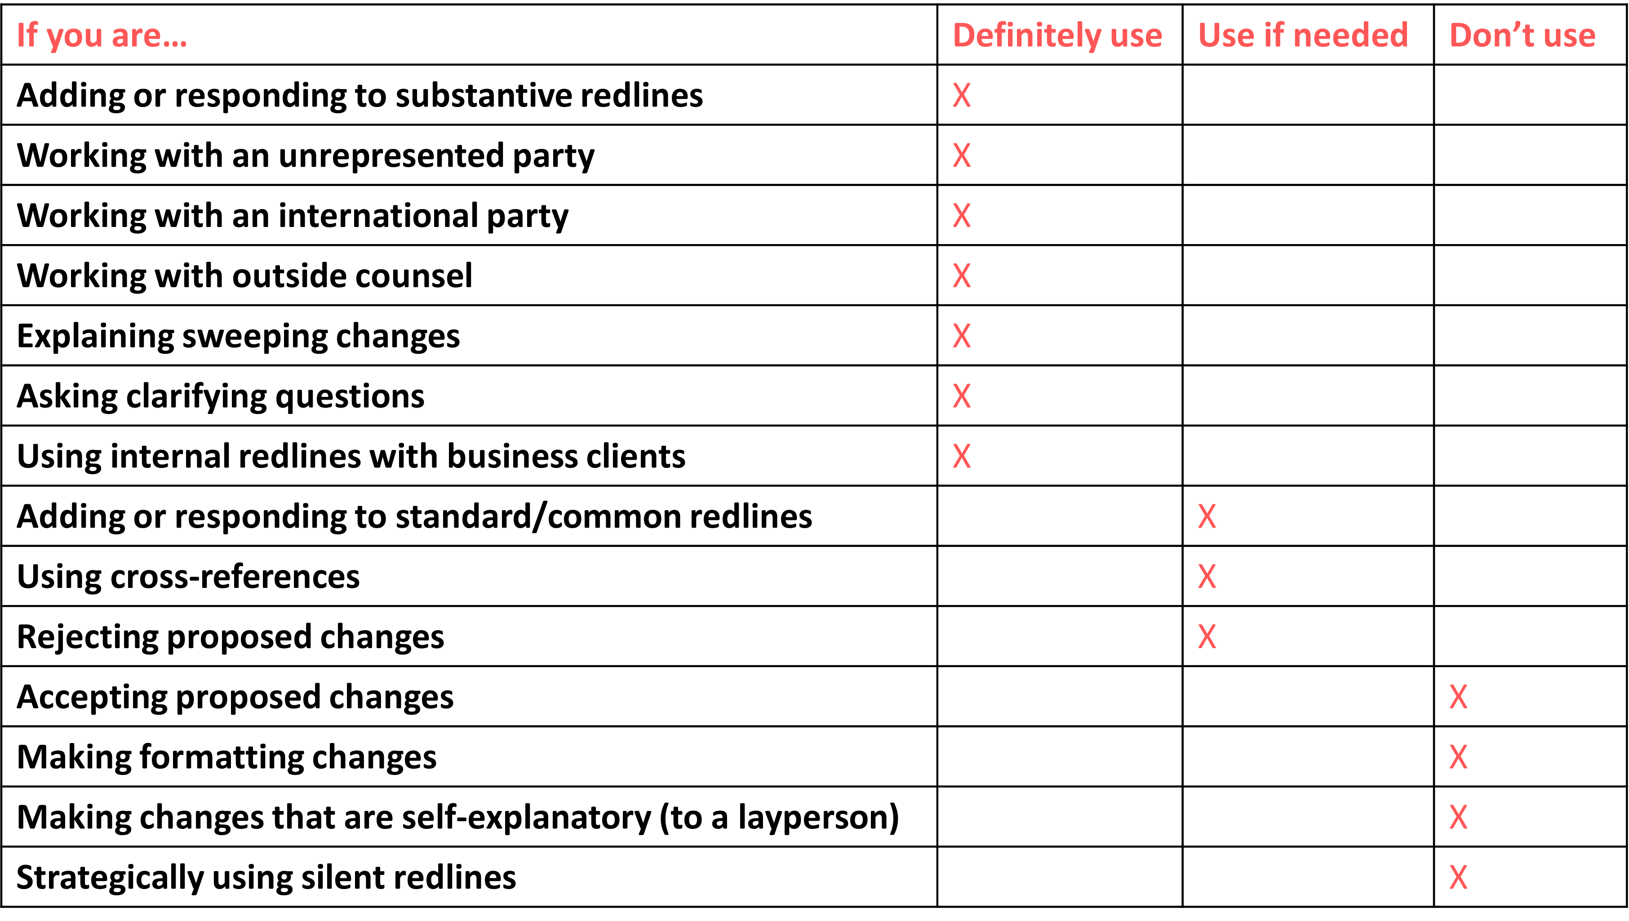
WHEN TO USE COMMENTS
Notes:
Always use comments with complex clauses.
Provide a high-level overview via email.
Be clear about WHY these changes are important to you.

Slide 22
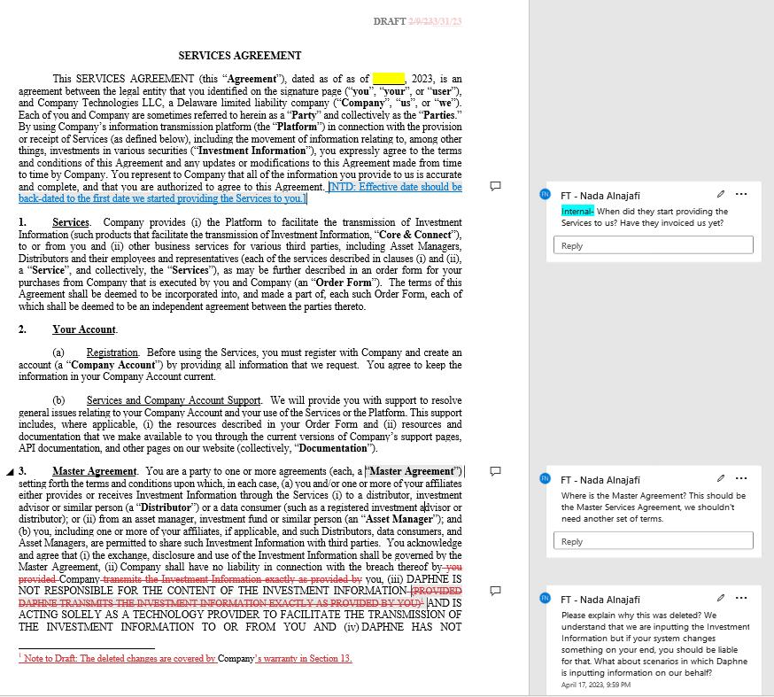
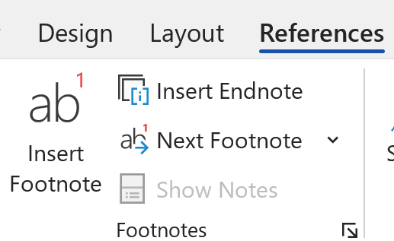
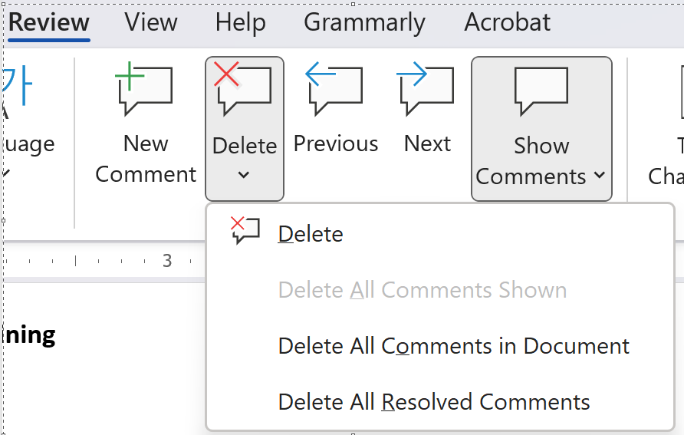
WHERE TO PLACE COMMENTS
In-line NTDs:
Hard to read
Hard to find
Hard to clean
Footnotes:
Hard to read
Easy to find
Hard to clean
In the margins:
Easy to read
Easy to find
Easy to clean
Notes:
Other lawyers are used to seeing footnotes, use margin comments where it makes sense. In-house clients would prefer this format.

Slide 23
5
Leverage internal redlines to build internal alignment.
Notes:
Match the defined terms and structure of the template you’re using
Don’t request/demand a change, propose the language that goes with your request
Focus on the important edits

Slide 24
REDLINES HELP FACILITATE INTERNAL ALIGNMENT
What’s the one thing you can’t finalize a contract without?
Your internal client.
Notes:
The more successful your internal negotiation is, the more successful your external negotiation will be.
After all, the internal negotiation is the most important preparation you can do for the external negotiation.
And that’s because one of the underlying factors of having a successful negotiation is the amount of time spent preparing for it.
In my redlining gone wrong example at the beginning, the vendor’s sales rep and in-house attorney were clearly misaligned. It was obvious they didn’t have a chance to discuss the matter before the call. When the in-house attorney threatened to lower our renewal period from 3 years to 1 year, only 2 days before quarter-end, the sales rep’s face completely changed. He was not expecting to lose 2/3 of his commission just like that.
Being misaligned with your client makes your negotiation vulnerable to interception. As soon as I noticed they were not aligned, I directed my negotiation to the sales rep. I asked him, “Are you sure you’re willing to give up a guaranteed $200k for an unlikely early termination? Of course the sales rep wasn’t willing to give up his commission for the in-house attorney’s mistake. Now the sales rep was on our side, and pushed his own in-house attorney to close the deal with a 3-year renewal period.
Had the vendor used internal redlines, they would have been more prepared for the negotiation call.
After all, as in-house counsel, we are reviewing contracts for goods and services that our business clients want to sell or purchase. Sure, we might be procuring legal services once in a while and be both the client and the counsel, but in most cases, we are the counsel. We offer advice so that our business clients can make informed decisions. So if we NEED our internal client in order to finalize the contract, then we NEED to involve them and align with them throughout the contract review and negotiation process.
When you have an internal client and multiple internal approvers or stakeholders to run clauses and terms by, the internal negotiation process can quickly become disorganized and difficult to track. Back in the day, I would manage internal negotiations through in-person meetings. Or send lengthy emails copy/pasting clauses from the contract that I wanted my internal client to review. Most of the time, my internal clients would reach out saying “what does this all mean” or “do I really need to read all of this?” or “can you just highlight the important parts for me.”
Those methods were not efficient because they relied on the client to understand legalese, to have enough time to read the whole contract and translate it for themselves, and it made them feel overwhelmed. Leading to shut down, frustration, and delayed feedback.
How can we run internal negotiations more smoothly and engage our client’s participation? By using Internal redlines.

Slide 25
REDLINES HELP FACILITATE INTERNAL ALIGNMENT
Ways to use internal redlines:
Color-code redlines to indicate audience
Delete and convert into external-facing redlines
Ask clarifying questions
Record approvals and decisions
Engage internal business clients
Navigate the deal together
Drive the negotiation forward
* Protect against unintended disclosure of attorney-client privileged communications or attorney work product.
Notes:
The more successful your internal negotiation is, the more successful your external negotiation will be.
After all, the internal negotiation is the most important preparation you can do for the external negotiation.
And that’s because one of the underlying factors of having a successful negotiation is the amount of time spent preparing for it.
In my redlining gone wrong example at the beginning, the vendor’s sales rep and in-house attorney were clearly misaligned. It was obvious they didn’t have a chance to discuss the matter before the call. When the in-house attorney threatened to lower our renewal period from 3 years to 1 year, only 2 days before quarter-end, the sales rep’s face completely changed. He was not expecting to lose 2/3 of his commission just like that.
Being misaligned with your client makes your negotiation vulnerable to interception. As soon as I noticed they were not aligned, I directed my negotiation to the sales rep. I asked him, “Are you sure you’re willing to give up a guaranteed $200k for an unlikely early termination? Of course the sales rep wasn’t willing to give up his commission for the in-house attorney’s mistake. Now the sales rep was on our side, and pushed his own in-house attorney to close the deal with a 3-year renewal period.
Had the vendor used internal redlines, they would have been more prepared for the negotiation call.
After all, as in-house counsel, we are reviewing contracts for goods and services that our business clients want to sell or purchase. Sure, we might be procuring legal services once in a while and be both the client and the counsel, but in most cases, we are the counsel. We offer advice so that our business clients can make informed decisions. So if we NEED our internal client in order to finalize the contract, then we NEED to involve them and align with them throughout the contract review and negotiation process.
When you have an internal client and multiple internal approvers or stakeholders to run clauses and terms by, the internal negotiation process can quickly become disorganized and difficult to track. Back in the day, I would manage internal negotiations through in-person meetings. Or send lengthy emails copy/pasting clauses from the contract that I wanted my internal client to review. Most of the time, my internal clients would reach out saying “what does this all mean” or “do I really need to read all of this?” or “can you just highlight the important parts for me.”
Those methods were not efficient because they relied on the client to understand legalese, to have enough time to read the whole contract and translate it for themselves, and it made them feel overwhelmed. Leading to shut down, frustration, and delayed feedback.
How can we run internal negotiations more smoothly and engage our client’s participation? By using Internal redlines.

Slide 26
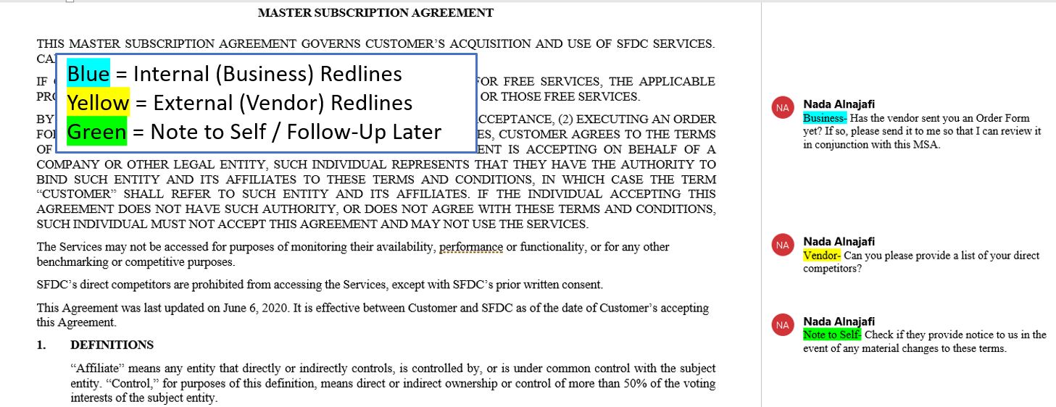
COLOR-CODING METHOD
*Be sure to remove all blue internal redlines before sharing with an external party. (See attorney-client privilege on the next slide.)
Notes:
The beauty of using a color-coding method is that it makes it easier and faster to visually filter the internal redlines out before sharing the version with the other side.
In addition, business folks love it! Whenever I have used this method to engage my clients, they have appreciated the clear direction and specific set of requests. Being clear with your asks and respectful of their time will help build internal trust. Plus, by using internal redlines instead of email, your internal clients will have all the information needed (e.g., specific language references) in one place. They (and you) won’t have to toggle back and forth between emails and contracts to recall the internal discussion.
If you are redlining in Word, you can simply highlight comments to indicate which audience the comment is intended for. This way, you can have collaborative discussions with your internal clients through the comment and reply function instead of having to go back and forth via email.
If you are using another redlining software, there will likely be a similar feature available. Some CLM providers automate this function by offering live collaboration platforms in which you can tag internal and external parties, and even hide the internal view from the external parties while working on one draft. Jerry Levine from ContractPodAi is going to show us how to collaborate with internal parties using their native platform.
You can apply these concepts to any redlining tool you use.
I was so excited when I learned about this color-coding method from a colleague of mine a few years ago. It helps us do exactly what our internal clients want us to do, highlight the relevant parts of the agreement that they need to review so they can skip over all the rest.
In addition, business folks love it! They appreciate the clear direction and specific set of requests. Being clear with your asks and respectful of their time will help build internal trust. Plus, by using internal redlines instead of email, your internal clients will have all the information needed (e.g., specific language references) in one place. They (and you) won’t have to toggle back and forth between emails and contracts to recall the internal discussion.
If you are redlining in Word, you can simply highlight comments to indicate which audience the comment is intended for. This way, you can have collaborative discussions with your internal clients through the comment and reply function instead of having to go back and forth via email. The beauty of using a color-coding method is that it makes it easier and faster to visually filter the internal redlines out before sharing the version with the other side.
In Partner Track, Murphy and Ingrid were reviewing the agreement in person together. That type of joint in-person review is extremely rare. Had one of them been at home or each of them been sitting in their own office, they probably would’ve told each through a phone call, IM, or email. Or, more ideally, via internal redlines. They could have shared those internal redlines with the managing partner and their client, Sun Corp. To make it more dramatic, like they do in TV shows, the attorneys called opposing counsel without running it by anyone else. But we know that internal collaboration and alignment is key. If Ingrid and Murphy had used internal redlines, here’s what I imagine they would have looked like.

Slide 27
PRESERVING ATTORNEY-CLIENT PRIVILEGE
Use these tips:
Label versions as Internal vs. External in the file name
Use “Attorney-Client Privileged” or “Work Product” labels within the document judiciously and appropriately
Provide instructions to the recipient about what they can and cannot do with the email text or attachment
Provide instructions to the recipient as how to provide their responses
The common interest doctrine generally allows parties with a common interest in a particular legal matter to share privileged information without causing a waiver. However, the breadth and utility of the common interest doctrine varies from jurisdiction to jurisdiction.
Under New York law, attorney-client communications are divided into two categories: (1) privileged communications regarding the general business operations of the target, and (2) privileged communications regarding the negotiations of the merger.¹
The Delaware Court of Chancery held that a surviving corporation owns and controls any attorney-client privilege that might attach to pre-merger communications.²
Notes:
Mixing up redlines not only causes confusion, but it also risks sharing information or strategies that otherwise would have provided a competitive advantage in the negotiation. Or worse, accidentally disclosing confidential or privileged communications. Make sure you clearly distinguish between external and internal redlines to avoid accidentally sending internal redlines to external parties.
Clearly define the scope of the attorney-client relationship: Before the negotiation begins, make sure that all parties involved understand that the communication between the attorney and the client is privileged. This includes defining the scope of the attorney's representation and what information will be kept confidential.
Limit the disclosure of privileged information: During the negotiation, the attorney should be careful not to disclose any privileged information that is not necessary for the negotiation. This can be achieved by carefully considering what information is relevant to the negotiation and limiting discussions to those topics.
Use caution when communicating with third parties: Be mindful of any third parties that may be involved in the negotiation, such as opposing counsel or other representatives. Communications with these parties could potentially waive the attorney-client privilege, so be sure to limit the disclosure of privileged information.
Label privileged communications: Label all written communications, such as emails or letters, as "privileged and confidential" to ensure that the recipients understand the confidential nature of the information.
Keep privileged information separate: Keep privileged information separate from other materials related to the negotiation, and limit access to the privileged information to only those who need to know.
References:
Tekni-Plex, Inc. v. Meyner & Landis, 89 N.Y.2d 123 (N.Y. 1996).

Slide 28
SAMPLE REDLINES
PARTY A CORPORATE CLIENT
PARTY B BRAZILIAN
RSTRNT
Notes:
Here is an example redline incorporating each of these concepts.
In this scenario, Party A is a corporate client looking to host a holiday event for their leadership team at Party B’s Brazilian steakhouse. They decide to use Party B’s Event Agreement template as the starting point. Party A begins the redlining process.

Slide 29
SAMPLE REDLINES
PARTY A CORPORATE CLIENT
PARTY B BRAZILIAN
RSTRNT
Notes:
Step 2: Party A reviews and sends internal redlines to IBC to gain better understanding of commercial terms & business risks.

Slide 30
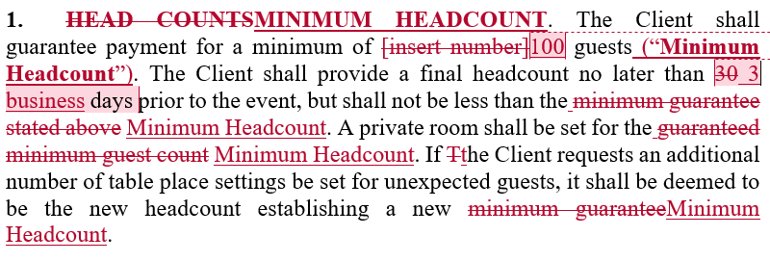
SAMPLE REDLINES
PARTY A CORPORATE CLIENT
PARTY B BRAZILIAN
RSTRNT
Comment is used to memorialize an agreement made over the phone.
Comment is used to explain the why and because of the ask.
Comment not necessary to explain the addition of a new defined term and application of the term throughout the clause because it is self-explanatory.
Notes:
Step 3: Party A incorporates input from IBC into first set of external redlines using explanatory comments to justify the proposed redlines.
x3 animations

Slide 31
SAMPLE REDLINES
PARTY A CORPORATE CLIENT
PARTY B BRAZILIAN
RSTRNT
Party B was fine with this change so Party B resolved this comment and accepted related redlines.
Party B backspaces Party A’s proposed redlines rather than clicking Reject, to prevent it from disappearing.
days.
Party B counters Party A’s offer for a reduced notice period using the why and because approach.
Notes:
Step 4: Party B reviews and responds to Party A’s redlines within the comments.
x3 animations.

Slide 32
6
Move out of email and into the live negotiation sooner.
Notes:
[Poll #4 – How many email exchanges do you usually have before you get on a call? A) 1 B) 2 C) 3 or more D) I try to avoid as much as possible]

Slide 33
CLOSING CONTRACTS FASTER
Party A
Party B
+
+
One exchange of redlines via email
Notes:
The contract review process is initiated via email. And it is usually completed via email. But during the negotiation phase, you should take advantage of the various communication modes offered to us. Sticking with email for too long can slow down the negotiation process. On the other hand, spending a week trying to schedule a call with a large group will also cause unnecessary delay. Use the mode of communication that will help drive the negotiation forward.
I’m located in Los Angeles and I recently negotiated a SaaS Agreement with a counterparty who’s located in Italy. We went through at least three email exchanges where very little progress was being made. My client wanted to sign the agreement by the end of Q3. So I asked my counterparty if we could schedule a video call to discuss the open items and they agreed. I opted for a video call instead of a voice-only call because I could sense a language gap and I knew that being able to see one another’s body language was going to help bridge that gap. You can opt to use a phone call, virtual call, video call, or (if feasible) an in person meeting. So many options at your fingertips aside from just email.
At the beginning of my video chat with my Italian counterparty, I told them how much I loved Italy and excitedly shared a few Italian words I knew. They told me how they’ve always dreamed of coming to Los Angeles. When we got to talking about the contract, I shared my latest redlines on the screen and began explaining our position on some of the major open items. We quickly realized that we agreed on many of points, it just took some conversation and explanation to get there. Meeting on a video conference helped us to not only connect on a personal level, but also to interpret what the words were intended to mean through body language, tone, and simultaneously reviewing the redlines. Using this method, we were able to finalize the open points on that call and sign later that week.

Slide 34
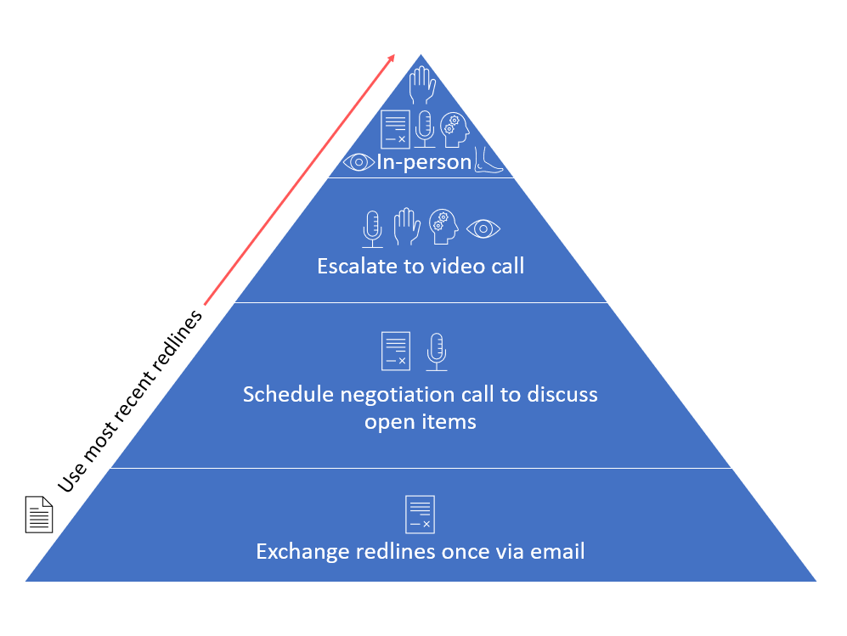
WHEN TO SWITCH?
Rule of thumb: Exchange redlines once and then switch to a live negotiation.
Email
Phone
Video
In-Person
5) Contract Redlines and Explanatory Comments
*Use different mechanisms at different points in the negotiation.
Notes:
POLL #4: What is your preferred method of communication when reviewing and negotiation deal documents?
The contract review process is initiated via email. And it is usually completed via email. But during the negotiation phase, you should take advantage of the various communication modes offered to us. Sticking with email for too long can slow down the negotiation process. On the other hand, spending a week trying to schedule a call with a large group will also cause unnecessary delay. Use the mode of communication that will help drive the negotiation forward.
I’m located in Los Angeles and I recently negotiated a SaaS Agreement with a counterparty who’s located in Italy. We went through at least three email exchanges where very little progress was being made. My client wanted to sign the agreement by the end of Q3. So I asked my counterparty if we could schedule a video call to discuss the open items and they agreed. I opted for a video call instead of a voice-only call because I could sense a language gap and I knew that being able to see one another’s body language was going to help bridge that gap. You can opt to use a phone call, virtual call, video call, or (if feasible) an in person meeting. So many options at your fingertips aside from just email.
At the beginning of my video chat with my Italian counterparty, I told them how much I loved Italy and excitedly shared a few Italian words I knew. They told me how they’ve always dreamed of coming to Los Angeles. When we got to talking about the contract, I shared my latest redlines on the screen and began explaining our position on some of the major open items. We quickly realized that we agreed on many of points, it just took some conversation and explanation to get there. Meeting on a video conference helped us to not only connect on a personal level, but also to interpret what the words were intended to mean through body language, tone, and simultaneously reviewing the redlines. Using this method, we were able to finalize the open points on that call and sign later that week.

Slide 35
SET UP THE MEETING FOR SUCCESS
Summary of attached documents
Progress status of each document
Critical open items and reasoning (keep it short)
Request to schedule a call with your and your team’s availability
Determine who will lead the call
Define the redlining process and expectations

Slide 36
7
Prepare for the live negotiation. Then prepare again.
Notes:
What is important to realize, is that redlines are more than just markups. They are our most powerful negotiation tool when it comes to negotiating contracts. And when used to their fullest advantage, they can help us get through the toughest of negotiations.

Slide 37
PREPARE FOR THE NEGOTIATION
Time Blocking
Internal Prep Meeting
Benchmark Industry Standards
Organize Redlines & Define Approach
Notes:
Time Blocking - Review the entire agreement, related threads, previous redlines, use time blocking method
Internal Prep Meeting – meet with internal clients, stakeholders
Benchmark
Research books, webinars, guides, checklists, Google, ChatGPT, other learning resources
TermScout for contractual clauses pre and post negotiation
Previous, similar deals from your organization
Previous, similar deals from past jobs
Discuss with colleagues, communities, mentors, outside counsel
Organize redlines and define approach
During a keynote talk at the World CC, a popular negotiation expert, Keld Jensen, shared that the first step to the negotiation process should be to negotiate how you’re going to negotiate. When it comes to contract negotiations, the HOW is redlining process. When you come across a deal with some level of complexity to it, make sure you align with your internal parties and your counterparties on what the redlining process should be.

Slide 38
SOP: PREPARE FOR THE NEGOTIATION
Step 1: Review latest redlines
Step 2: Add my comments, questions, thoughts, action items in the comments
Step 3: Send internal redlines to internal clients/stakeholders and schedule a meeting to review with them
Step 4: Update the redlines so all comments are external-facing
NOTE: Be sure to remove all internal-facing comments before sending externally to preserve attorney-client privilege and attorney work product – and to maintain negotiation leverage. (See Appendix – Attorney-Client Privilege)
Step 5: Send email to counterparty with latest redlines attached and a high-level overview of open items and next steps via email. Includes request to meet.
Step 6: Schedule meeting.
Step 7: Meet with internal clients and stakeholders day before or day-of external negotiation call to prep.
Step 8: Attend negotiation call prepared and confident!

Slide 39
Understand the specific risk tolerance for this negotiation
Align internally:
What is the size of this deal?
Who is the ultimate decision maker?
What is your insurance coverage?
What is the practical implications of liability?
How much negotiation power do you have?
What is the business need for this contract to close?
What are the must-haves?
When can you renew/re-negotiate?
What is the highest risk you're willing to accept as the ultimate fallback plan?
Will this impact any other contract or business issue (financing, due diligence, insurance).
Notes:
Megan

Slide 40
ALIGNING ON RISK INTERNALLY
Escalation pathways
Signing or exception authority delegation
Risk frameworks
Pre-aligning internally on first, second, or third stances and who has authority to approve liability levels will expedite the process.
Which stakeholders need to weigh in?
Notes:
MEGAN

Slide 41
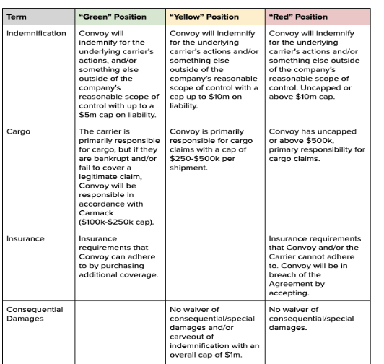
SAMPLE RISK ASSESSMENT TEMPLATE

Slide 42
HOW TO USE CHATGPT TO PREP FOR THE NEGOTIATION
Negotiation Prep Involves:
Understand the reasons you are proposing change
Be able to articulate it in a way that your counterparty can understand
Anticipate what your counterparty’s issue or counteroffer will be with your proposal
Counter propose a third solution that balances the needs of both sides
ChatGPT Limitations to Be Aware of:
Opt out of sharing inputs to train ChatGPT
Don’t use confidential, sensitive, or attorney-client privileged information
Don’t use PII or otherwise protected data
Don’t use company’s proprietary information, IP, or trade secrets

Slide 43
HOW TO USE CHATGPT TO PREP FOR THE NEGOTIATION
1. Isolate a contractual issue that you think may be difficult to negotiate

Slide 44
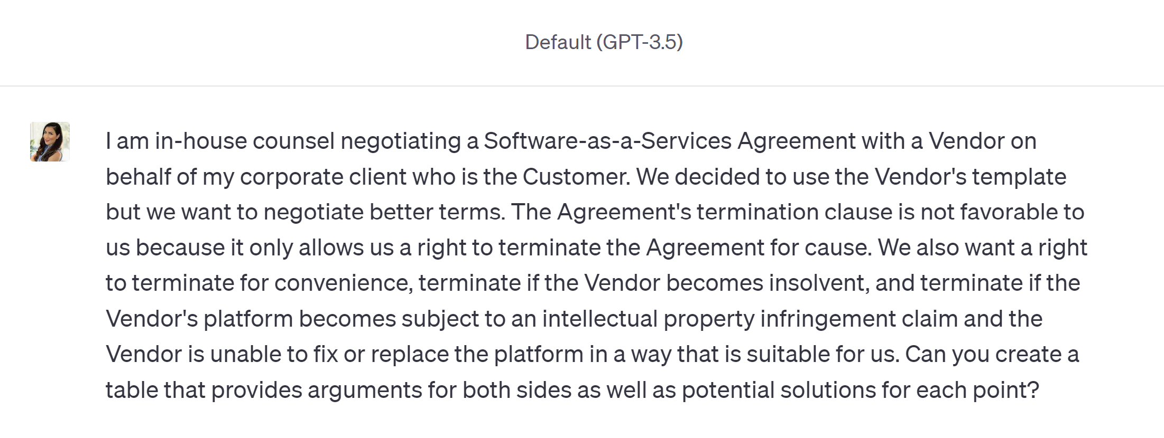
HOW TO USE CHATGPT TO PREP FOR THE NEGOTIATION
2. Draft a clear prompt

Slide 45
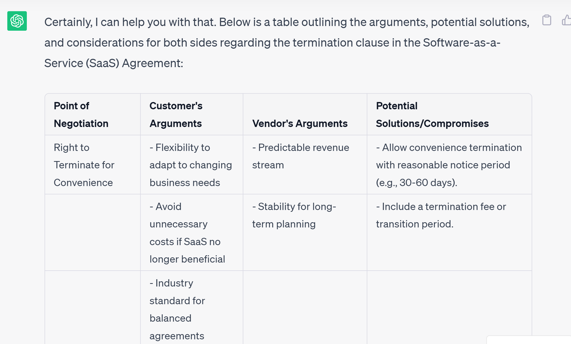
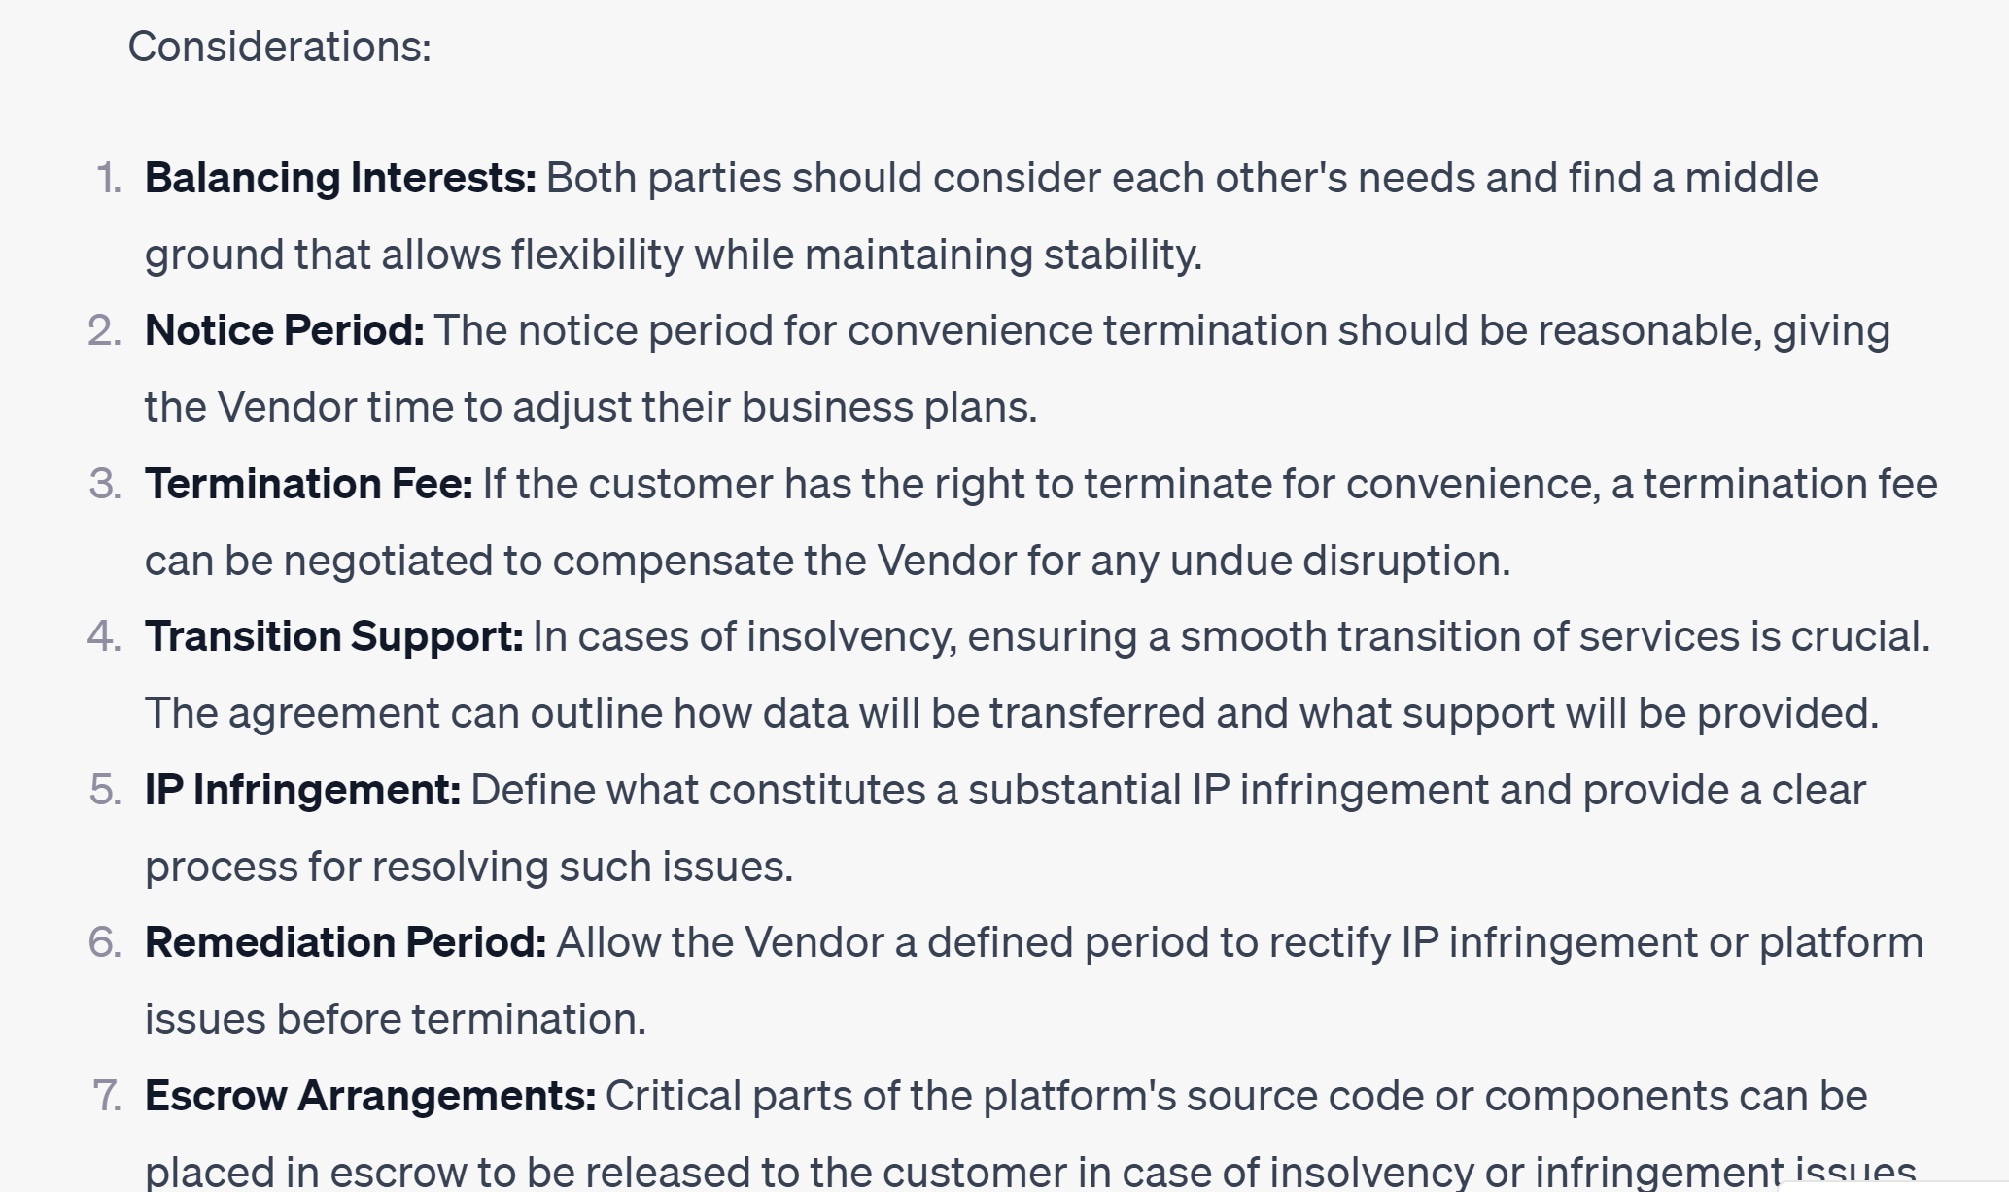
HOW TO USE CHATGPT TO PREP FOR THE NEGOTIATION
3. Review the output. Refine if needed. Verify if needed. Take what you like.

Slide 46
8
Navigate difficult negotiations.
Notes:
According to a study done by Huthwaite International, skilled negotiators use way less irritators. Irritators are certain words and phrases that are commonly used during negotiations that cause irritation to the other party.
Fair/reasonable – implies the other party is being unreasonable or unfair
“This is our company policy”
“This is a generous offer”

Slide 47
IRRITATORS TO AVOID
❌Please do not:
Sending redlines in PDF format
Using the "Lock Tracking" feature in Microsoft Word
Turning Track Changes off while making changes to the document
Not providing enough explanatory comments
Click the “Reject” button to reject our markups – instead use the backspace button
Showing up to a negotiation call without having reviewed the latest set of redlines
Say “This is industry standard”
Notes:
Question for the chats: What are some things that counterparties have said to you during negotiations that really gets under your skin?

Slide 48
WHAT EVEN IS INDUSTRY STANDARD?
Trusted Benchmarking Data
Previous deals
Community, colleagues, mentors
Notes:
Benchmarking – Term Scout, Ponemon Institute
Previous Deals – Memory or contracts database
Ask around – Contract Nerds, How to Contract, etc.

Slide 49
DELIVER WITH CONFIDENCE
Be Yourself
Turn Your Camera On
Lead the Discussion
Ask Good Questions

Slide 50
SAYING “I DON’T KNOW” WITH CONFIDENCE
Can you help me understand this point a little better?
Would you be more comfortable if we said this instead?
Can you give me an example of how that would apply here?
That’s a good question for our data privacy expert.
Let me review internally and get back to you on that.
Notes:
Also try to avoid getting stuck by preparing in advance for the negotiation.

Slide 51
WAYS TO BUILD CONFIDENCE
Take Risks
Observe / Shadow
Request Feedback
Try New Things
Prepare Detailed Redlines
Invest in mastering redlining, negotiation, and plain language drafting skills

Slide 52
9
Working with counterparties who do not follow redlining etiquette.

Slide 53
WHEN COUNTERPARTY SENDS UNEDITABLE TEMPLATE
PDF – Convert it to Word yourself or ask for an editable version
Word with Lock Tracking – Remove the Lock Tracking feature yourself or request a version without it
Click-Thru – Request an editable version, copy/paste into Word, draft an Amendment with proposed changes, or see if there’s an ordering document you can add customized terms to

Slide 54
WHEN A COUNTERPARTY DOESN’T USE COMMENTS
Address where appropriate. Most of us learn through observation.
Request comments
"Thank you for providing your proposed redlines. To help us better understand your position, would you please add explanatory comments? Afterward, we can schedule a call to chat about the open items. Appreciate it!“
2. Schedule a call
“Thank you for providing your proposed redlines. I had a couple questions around the changes made to the indemnification and limitation of liability clauses. Let’s schedule some time to chat tomorrow. If possible, please send over an updated version explaining why you made these changes within the comments so that I can review and prepare prior to our call. Appreciate it!”
“Please find an updated version attached with our feedback. I attempted to draw assumptions as to why certain requests were made but please use explanatory comments for the next draft. It will really help speed things along. Thanks!”
3. Review as-is
Notes:
[POLL #2: Have you ever received a draft contract from the other party containing lots of redlines and zero explanatory comments? A. Yes. B. No.
If your counterparty does not provide sufficient explanatory comments, there are a few things you can do to keep the negotiation on track. The appropriate response here is the one that will engage your counterparty’s cooperation and successfully and timely close the negotiation for your client. Adjust your approach based on the level of criticality and urgency of the deal.
1. Request Comments
One option is to send the contract back to your counterparty and politely ask them to add explanatory comments, particularly if they have made a lot of unclear or overreaching edits. The key is to explain your why and because of your ask. State why you want them to add explanatory comments and how it will help them. For example, "Thank you for providing your proposed redlines. To help us better understand your position, would you please add explanatory comments? Afterward, we can schedule a call to chat about the open items. Appreciate it!"
2. Schedule a Call
If you review the contract and only have a couple questions about why certain changes were requested, schedule a call to get some clarity on those points.
3. Review As-Is
For urgent or critical contracts, you may not have time to send the contract back to your counterparty. In that case, you should review the contract without comments and request clarification on the redlines that require more discussion. If you don’t understand or don’t want to accept a proposed redline, add an explanatory comment to that effect.

Slide 55
WHEN A COUNTERPARTY SENDS HIDDEN REDLINES
Is the hidden redline material to the deal?
Yes
Notify your internal business client.
No
Let it go.
Come up with a plan together.
Address with counterparty over the phone.
Leverage the mistake to your favor.
Notes:
If you receive a contract draft with hidden changes from a counterparty, don’t assume the worst right away but also, don’t ignore it. That will only precipitate the transparency problem because that person may not even know that they’re doing it.
In Partner Track, again spoiler alert, but Ingrid calls opposing counsel and essentially calls them out on the consequential damages exclusion. But she is prepared for the negotiation and readily offers a give-and-take scenario that opposing counsel ultimately agreed to. In this show, the hidden redline was likely added maliciously, but in real life, its often just a mistake or oversight. So always be professional and give the benefit of a doubt to your counterparty. But also, always, double check the agreement before you approve it for execution.

Slide 56
10
Collect and analyze contract data after execution.

Slide 57
DATA IS CRUCIAL TO INCREASE PERFORMANCE AND EFFECTIVENESS AND MAKE BUSINESS CASES
Understand the velocity (rate to close and where contracts stalled)
Understand which terms are causing the most friction
Understand closure rate
Understand correlations: does duration of contract lifecycle indicate rate of execution?
Use this data to suggest different redlining approaches, different risk tolerances, different training, different partnership with sales team.
Use data to have conversations with sales teams, leadership teams, and cross-functional groups to be one the same team to execute agreements and modify process.

Slide 58
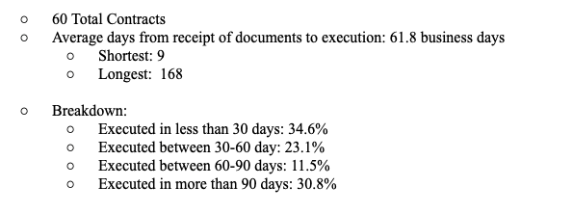
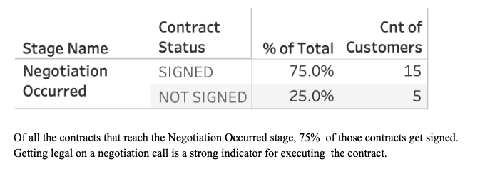
EXAMPLES OF CONTRACTING DATA

Slide 59
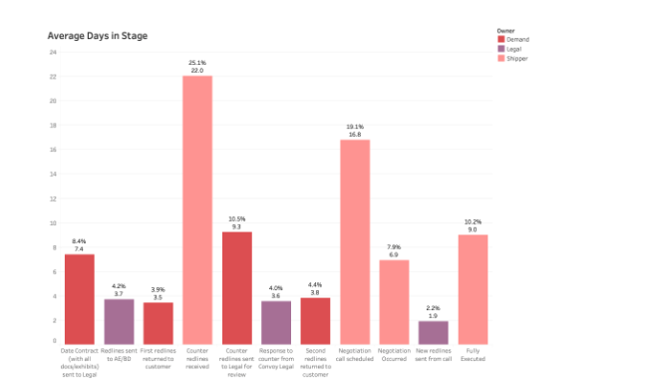
EXAMPLES OF CONTRACTING DATA

Slide 60
EXAMPLES OF CONTRACTING DATA

Slide 61
THANK YOU!

