Slide 1
Creating a Data Retention Policy for Privacy that Avoids Conflicts

Slide 2
Disclaimer
The opinions expressed here are those of the speakers and not necessarily the opinions of their employer, the ACC, or any other entity.

Slide 3
Speakers
Kaye Cyrus is Corporate Counsel at HealthEdge, a technology company in the healthcare industry. With experience in the financial services, healthcare, retail, and technology industries Ms. Cyrus advises senior and executive management on strategy, business, and legal matters, including contracts, privacy, and compliance. She is a leader who operates well in a matrixed environment and creates clarity out of ambiguity.
David Gilmartin serves as general counsel for American Health Information Management Association (AHIMA), a global not-for-profit organization of health information professionals and the nation’s leading voice and authority in health information. He also supports AHIMA’s affiliate, AHIMA Foundation, and AHIMA’s international division AHIMA International. His practice includes a broad spectrum of disciplines from international and domestic perspectives, including general corporate, health law, contracts, intellectual property, litigation, compliance, privacy, and employment law.
Kerry Childe is a Senior Consultant with Contoural, Inc., and a practicing attorney. She has provided privacy and information protection consulting and legal services to clients ranging from startups to global corporations. She has 20 years of information counsel experience, leading the development and implementation of enterprise-wide privacy and information protection programs to protect company information. She has previously worked as Senior Corporate Counsel for a Fortune 100 company and Senior Privacy and Regulatory Counsel for a nonprofit student lending organization.
Mark Diamond is the founder and CEO of Contoural, Inc. He is one of the industry thought leaders in proactive records management, privacy, litigation readiness, compliance and governance strategies. As a trusted advisor he and his company work with more than 30% of the Fortune 500, plus many mid-sized firms, federal agencies, as well as non-profits.

Slide 4
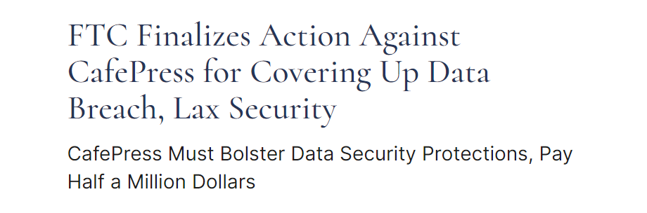
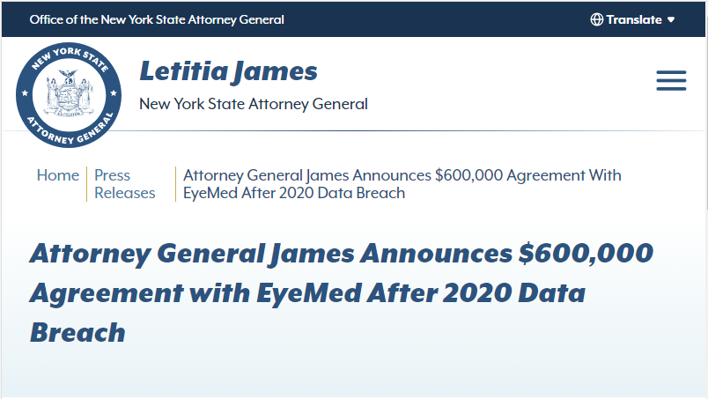
Privacy is Driving Data Retention and Deletion Policies
Enforcement of data minimization is driving new looks at existing processes.

Slide 5
EU Demands May Invade the US
“While they never said why they were doing it, we did find that terminated employees would make broad data requests on us either for discovery purposes (of limited use in Europe) or because of the cost of searching and producing the information. We heard from our outside counsel that’s what people were doing as a way of extracting more in settlements from the companies that they made the requests from.”
- Associate General Counsel, Fortune 100 Company

Slide 6
Getting Stuck
Privacy requires disposition
Reaches out to IT
IT reaches out to legal for policy
Legal brings in records management
Records management says records need to be saved
Business units don’t want to delete
What should we save? Can we delete?
Committee formed
Committee meets
Committee meets
Committee meets…
Committee meets…
Source: Contoural, Inc.

Slide 7
Data Retention Policy vs. Records Retention Policy and Schedule
New Data Retention Policy
Record Retention Policy and Schedule
vs.
Legal and Regulatory Retention and Disposition Requirements
Business Value
Personal Information
Legal and Regulatory Retention Requirements
Business Value

Slide 8
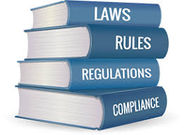
Records Retention and Disposition Requirements
Information – business records – generally must be kept for some period of time, defined by the law and by a company’s records retention schedule.
In many cases, the company’s business need for information is longer than the legally-mandated retention period – that is, the business utility of that information lasts longer than the legal utility.

Slide 9
Defining Retention
A (good) record retention period represents both legal and business need.
For most record types, the length of time the information is useful to the business is much longer than the minimum time a law may require such a record to be kept.
Citation | Records to be Kept | Retention/Limitation Period | Company Retention
26 CFR 31.6001-1(e)(2) | Copies of returns, schedules, statements and other supporting documents related to payment of employment taxes and income tax withholding. | 4 years after the date the tax is due, or paid | 7 years after the year in which the tax was due or paid
Organizations will keep their employment tax documents much longer than 4 years, because the business need is to keep financial information together and for a defined period of time (usually 7 or 10 years).

Slide 10
Personal Information Retention and Disposition Requirements
Personal information is information. It goes through the information lifecycle like all other information.
However, many privacy laws require that personal information, unlike other information, be kept “no longer than necessary” and be able to be deleted on demand by the data subject.

Slide 11
Defining Retention for Personal Information
A retention period for personal information also needs to represent both legal and business need.
Citation | Records to be Kept | Retention/Limitation Period | Company Retention
Cal. Gov’t Code § 12946 | Any and all applications, personnel, membership, or employment referral records and files; personnel files of applicants or terminated employees | 4 years after the records/files are initially created/received, or 4 years after the date the employment action was taken | End of employment + 6 years
However, there is a third input: legal limitation.
Citation | Records to be Kept | Retention/Limitation Period | Company Retention
Cal. Bus. and Comm. Code § 1798.100 | Personal information, sensitive personal information | No longer than is reasonably necessary for [the] disclosed purpose | ?????

Slide 12
When Record Retention and Privacy Requirements Collide
So how do you keep business records and information for as long as the business utility exists, but only keep personal information “no longer than necessary” and be able to delete on demand?
Use your records retention schedule processes to help.
Just as you work through the business and legal need for other records, do the same for your records containing personal information.
COLLISION

Slide 13
Data Retention Policy vs. Records Retention Policy and Schedule
New Data Retention Policy
Record Retention Policy and Schedule
Legal and Regulatory Retention Requirements
Business Value
Add personal information
Add legitimate business need
You do not need a new document – you already have the tools you need to appropriately manage and retain personal information. Irrespective of the title of the document/s, they provide the same information: the length of time you must keep records.

Slide 14
Steps for Creating a Records-enabled Data Retention Policy/Privacy-enabled Records Retention Schedule
Include an Inventory of All Information Types
Apply Legal and Regulatory Retention Requirements
Determine Business Value of the Records
Address Records Containing Personal Information
Include Disposition Requirements
Identify Legitimate Business Need for the Retention Period
Consider the Need for Legal Holds
Obtain Consensus with the Business

Slide 15
Can Personal Information Be Retained Longer Than the Record Retention Legal Requirement?
One Year | Two Years | Three Years | Four Years | Five Years | Six Years | Seven Years | Eight Years | Nine Years | Ten Years | Eleven Years
Legally Required Record Retention
Reasonable Business Justification
Beyond Legitimate Business Need

Slide 16
What’s Reasonable?
Auto Manufacturer
Long-term durable goods
Multi-year warranty
May be subject to recall many years after purchase
Golf Ball Retailer
Short-term goods purchased frequently
Generally no post-purchase support

Slide 17
Personal Information Business Justification Process
Is this longer retention reasonable and in line with purpose for which it was collected?
Document the legitimate business need for the retention.
Does it contain personal information?
Is the business value of the record longer than the retention period of the personal information?

Slide 18
Privacy-enabled Records Retention Schedule
Retention Justification
Laws in Q state, where we are headquartered, require that we keep formal corporate information permanently. Laws in X and Y countries, where we have substantial operations, require that we keep formal corporate information permanently. As a corporation, having a historical records of all decisions made by the Board of Directors is important to our ongoing business.
Address Records Containing Personal Information
Personal Information
Conflict of Interest Forms Shareholder Records Corporate Minutes Corporate Resolutions
Identify Legitimate Business Need for the Retention Period

Slide 19
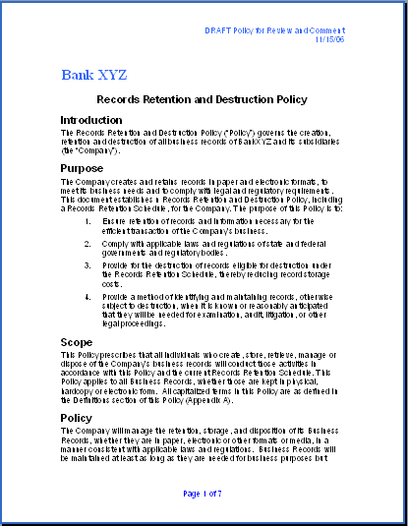
How Do Regulators Measure Compliance?
What Did You Say You Were Going To Do?
Policies
Schedules
How Did You Do It?
Tools
Processes
File Plans
How Did You Check You Did It?
Training
Surveillance
Metrics Tracking
Reporting
Audit
Updates
Policy
Schedule
File Plan
HQ Finance
Record
Retention
SharePoint Folder
Sub-folder
Record Type
Category
Period
90 Days
Source: Contoural, Inc.

Slide 20
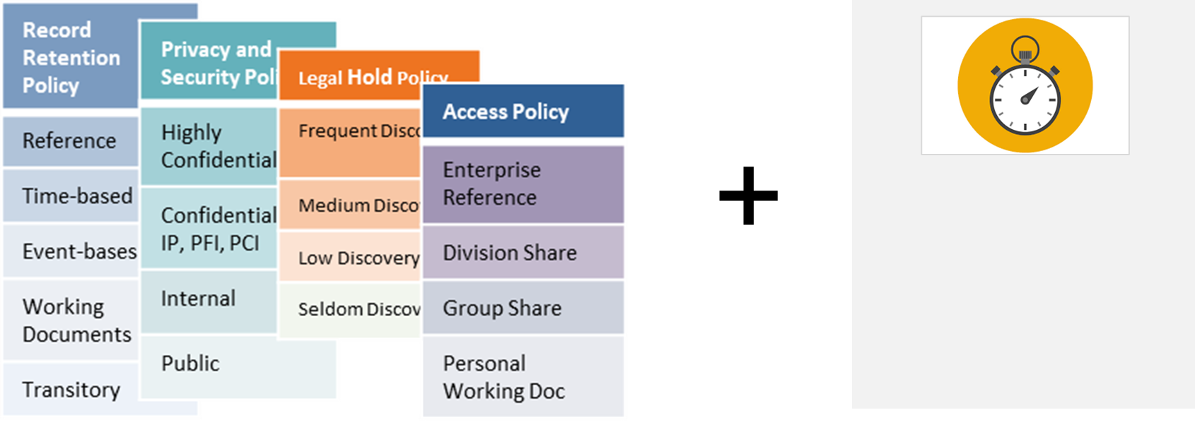
Automating Retention and Disposition
Five-Second Rule

Slide 21
Join Us For Session 404
Legal Initiative Pitch Contest
An interactive session you will not want to miss!
4:00 – 5:30pm

Slide 22
New Resource
ACC Guide – INSERT
See us at booth 605 to get your
complimentary resources

Slide 23
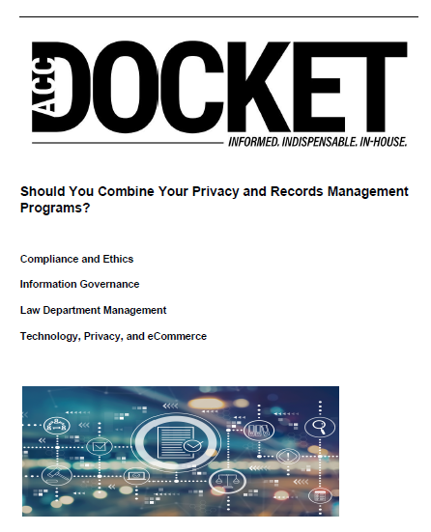
Thank You and Additional Information!
Kaye Cyrus
Corporate Counsel, HealthEdge
kcyrus@healthedge.com
David Gilmartin
General Counsel, AHIMA
David.Gilmartin@ahima.org
Kerry Childe
Senior Consultant, Contoural
kchilde@contoural.com
Mark Diamond
President & CEO, Contoural
mdiamond@contoural.com
Guide: Creating Modern, Compliant and Easier-to-Execute Records Retention Schedules
Article: Should You Combine Your Privacy and Records Management Program
Guide: Deleting Emails and Files Quickly and Defensibly

