Slide 1
Legal Update Antitrust in the Healthcare Sector April 2, 2024

Slide 2
Introduction
Benjamin R. Dryden
Partner and Vice Chair, Antitrust Practice Group
Washington, D.C.
T: 202.945.6128
E: bdryden@foley.com

Slide 3
Agenda
Renewed Antitrust Focus on Healthcare
Expansion of Merger Guidelines
Antitrust Enforcement Developments
Horizon-Scanning

Slide 4
Agenda
Renewed Antitrust Focus on Healthcare
Expansion of Merger Guidelines
Antitrust Enforcement Developments
Horizon-Scanning

Slide 5
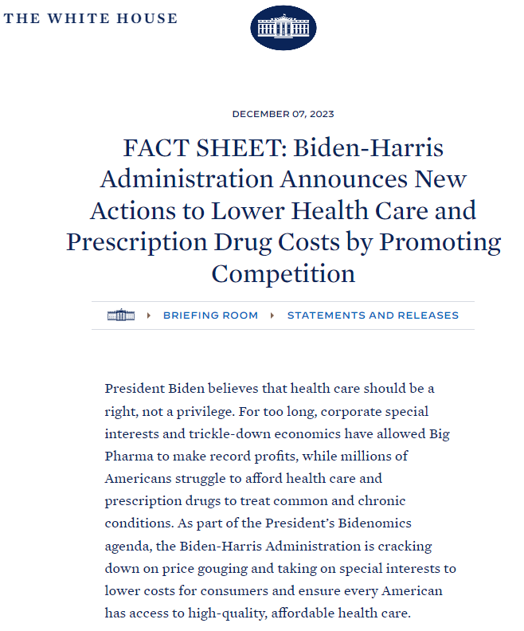
Competition in Healthcare
On December 7th, the White House announced a series of initiatives “to promote competition in health care:”
HHS, FTC, and DOJ to work together to identify “roll-up” acquisitions that may lessen competition
HHS and Dept. of Commerce to start considering pricing as a factor in whether to exercise “march-in” rights for drugs/devices/other inventions under the Bayh-Dole Act
CMS to increase transparency of data about ownership of FQHCs/Rural Health Clinics and performance of Medicare Advantage plans
Creating new offices in HHS, FTC, and DOJ
These initiatives are explicitly tied to “Bidenomics” – “cracking down on price gouging and taking on special interests to lower costs for consumers.”

Slide 6
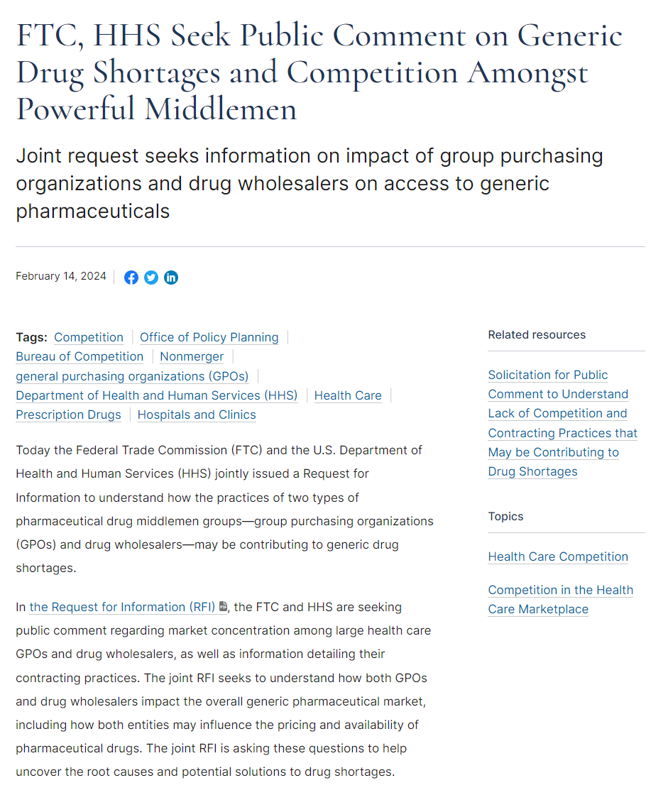
Focus on Drug Shortages
As a first step in response to the White House announcement, in February the FTC and HHS issued a “Request for Information” about whether market concentration and/or “contracting practices” among GPOs or drug wholesalers may be contributing to shortages for generic drugs.
Not a rulemaking, but meant to inform potential regulatory responses or enforcement decisions
Comments are due May 30th (extended from April 15th)

Slide 7
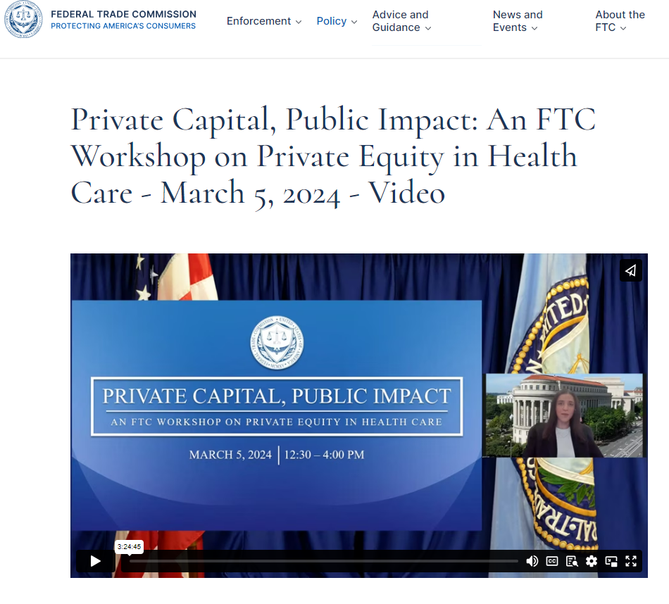
Focus on Private Equity
As a next step, on March 5th the FTC held a half-day “workshop” on the topic of “Private Equity in Health Care.”
Lina Khan, the Chair of the FTC, opened the event: “Over the last two years the FTC has heard an outpouring of concern about the ways that private equity buyouts in healthcare have worsened outcome[s] for workers and patients alike… [F]irms of all types should be on notice.”
Speakers – hand-picked by the FTC – were uniformly critical of private equity, criticizing its perceived short-term investment horizons and extractive (“strip and flip”) business models.

Slide 8
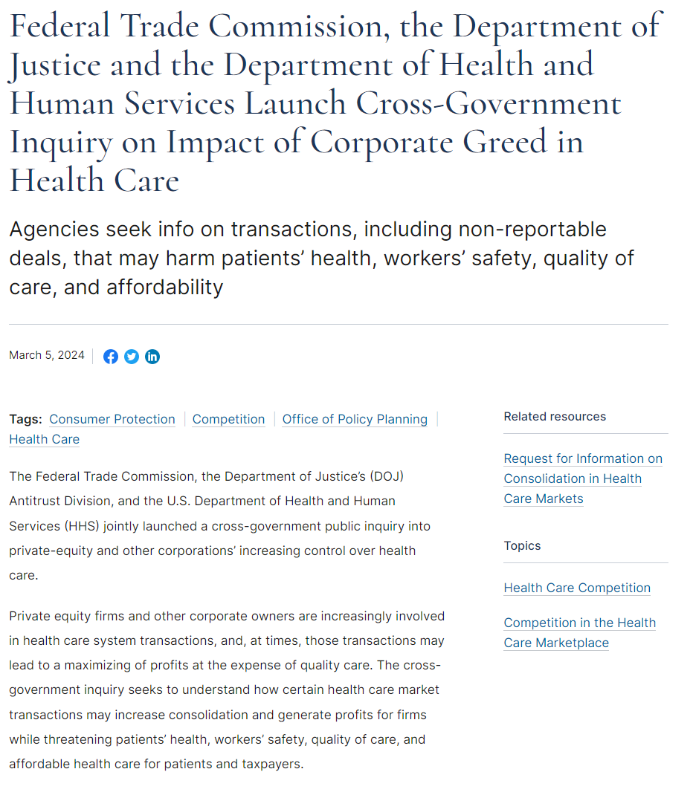
Focus on Consolidation/“Greed”
That same day, FTC, DOJ, and HHS issued a request for information about “consolidation in health care markets.”
Seeking information about the effects of M&A of healthcare providers – a subject the agencies already know very well
Comments due May 6th (might be extended further)
The FTC’s press release called the request an inquiry about “corporate greed in health care.”
Also references “private equity roll-ups, strip-and-flip tactics, and other financial plays that can enrich executives but leave the American public worse off”

Slide 9
Agenda
Renewed Antitrust Focus on Healthcare
Expansion of Merger Guidelines
Antitrust Enforcement Developments
Horizon-Scanning

Slide 10
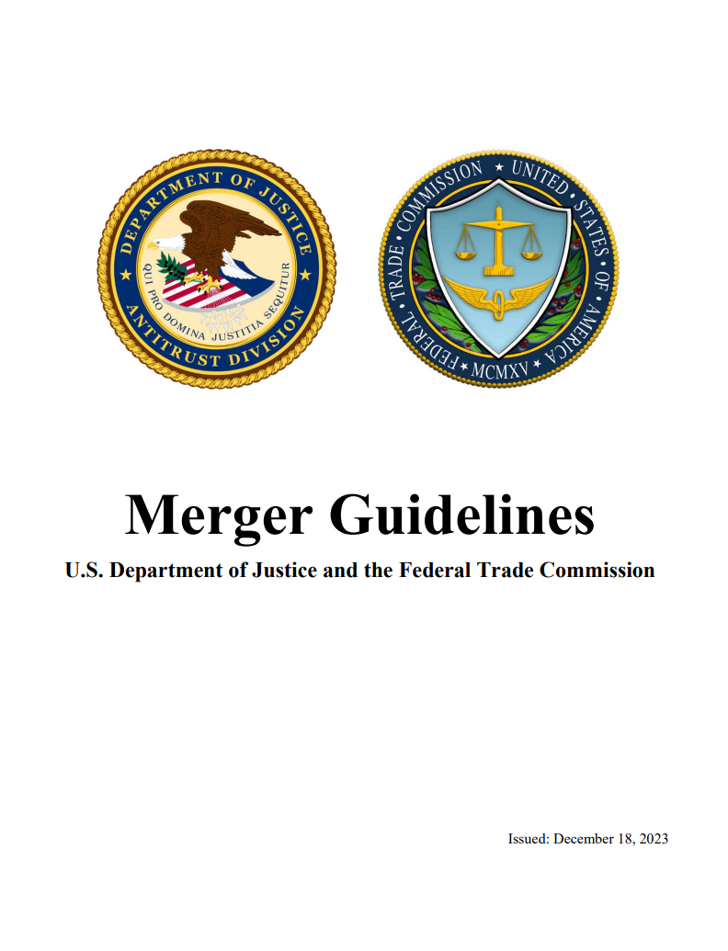
Revised Merger Guidelines
The Biden Administration’s most significant antitrust reform to date is a comprehensive revision of the federal Merger Guidelines, the document that lays out the framework DOJ and FTC use to review mergers.
Replaces the prior Horizontal Merger Guidelines (adopted by Obama Administration in 2010 with broad bipartisan support) and the Vertical Merger Guidelines (adopted in 2020 by Trump Administration, with somewhat narrower support).
Merger Guidelines do not independently have the force of law.
But courts have historically given great weight to the Merger Guidelines as persuasive authority—at least in part because parties have accepted prior versions of the Guidelines as accurate statements of law and economics.

Slide 11
Key Changes to Merger Guidelines
The revisions are a top-to-bottom rewrite of the Merger Guidelines. Notable changes include:
Reviving a 1960s-era presumption that a merger between competitors is illegal if the parties would combine to a >30% market share; strengthening other structural presumptions
Expanding analysis of vertical mergers to consider whether the combined firm has both the “ability and incentive” to disadvantage rivals
Considering whether a merger may “entrench or extend” an already-dominant position
Analyzing effects of mergers on workers or suppliers
Competition involving multi-sided “platforms” – competition between platforms, within a platform
Considering whether a merger is part of a larger “series” of acquisitions (e.g., “roll-ups”), or if the overall industry has seen a larger trend towards consolidation
Expanded analysis of “potential competition” issues

Slide 12
Agenda
Renewed Antitrust Focus on Healthcare
Expansion of Merger Guidelines
Antitrust Enforcement Developments
Horizon-Scanning

Slide 13
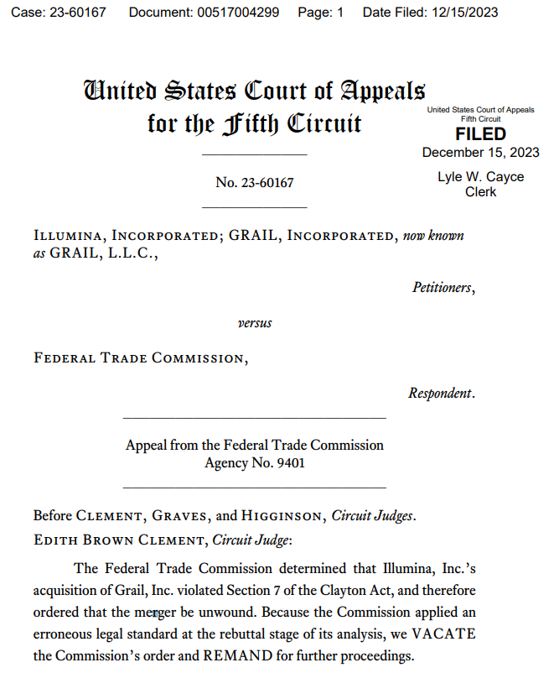
“Vertical” Merger Decision
In December, the Fifth Circuit Court of Appeals gave the FTC the first litigated victory in a “vertical” merger challenge in over four decades.
The transaction would have combined the leading supplier of next-generation sequencing platforms with the only current supplier of multi-cancer early detection tests.
The Fifth Circuit, using a “substantial evidence” standard of review, upheld the FTC’s finding that the combined firm would have the “ability and incentive to foreclose rivals from sources of supply or distribution,” thereby potentially harming competition for potential entrants into detection tests.
The revised Merger Guidelines came out the next business day, citing the Fifth Circuit’s decision three times.

Slide 14
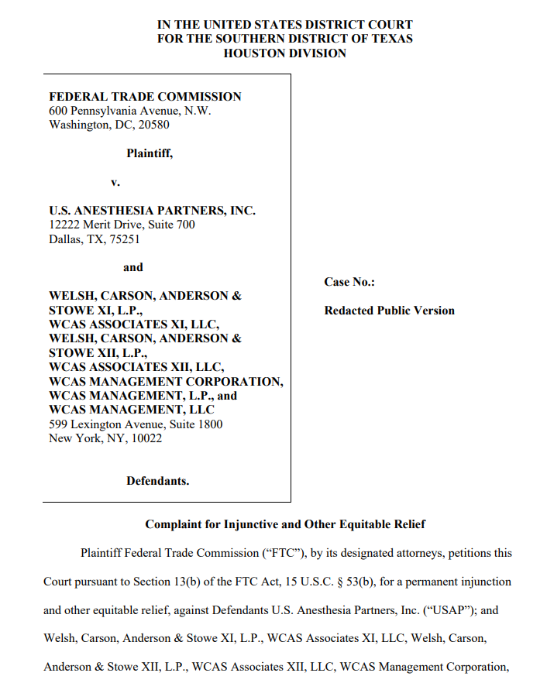
“Roll-Up” Acquisitions
In September 2023, the FTC sued U.S. Anesthesia Partners and its private equity owners (Welsh Carson) for a “roll-up scheme” to acquire over a dozen hospital-based anesthesiology practices (>1,000 doctors) across the State of Texas.
Acquisitions spanned multiple cities (Dallas, Houston, San Antonio, others), targeting a mission-critical service line for hospitals.
FTC alleges that after each acquisition, USAP raised rates for payors.
Case reflects new enforcement theory – “monopolization,” even if no individual acquisition substantially lessened competition on its own

Slide 15
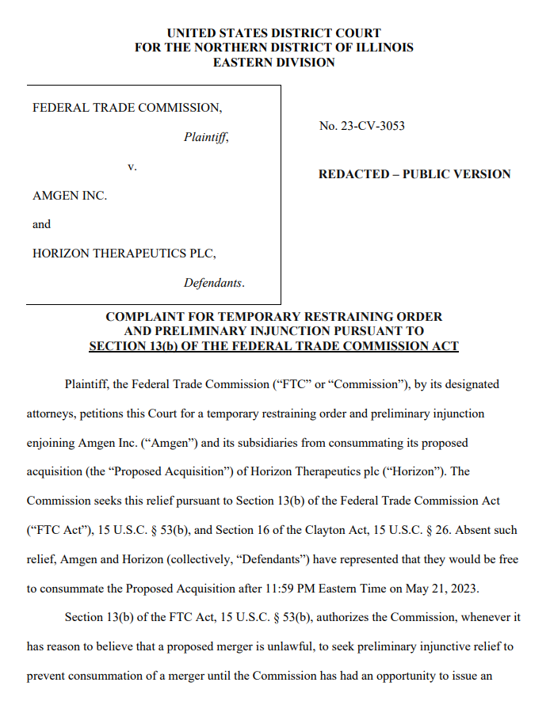
Pharmaceutical Merger Litigation
In May 2023, the FTC sued Amgen and Horizon Therapeutics, the first litigated challenge to a pharma merger in 14 years
Six states – CA, IL, MN, NY, WA, and WI – eventually joined as plaintiffs as well
Significantly, Horizon and Amgen did not compete head-to-head for any treatments
Horizon has a pair of orphan drugs for thyroid eye disease and for chronic refractory gout – conditions not within Amgen’s portfolio
Instead, the Government’s theory was that Amgen could use “cross-product bundling” to secure exclusivity or preferential placements from PBMs, disadvantaging rivals that lack as broad a portfolio of drugs

Slide 16
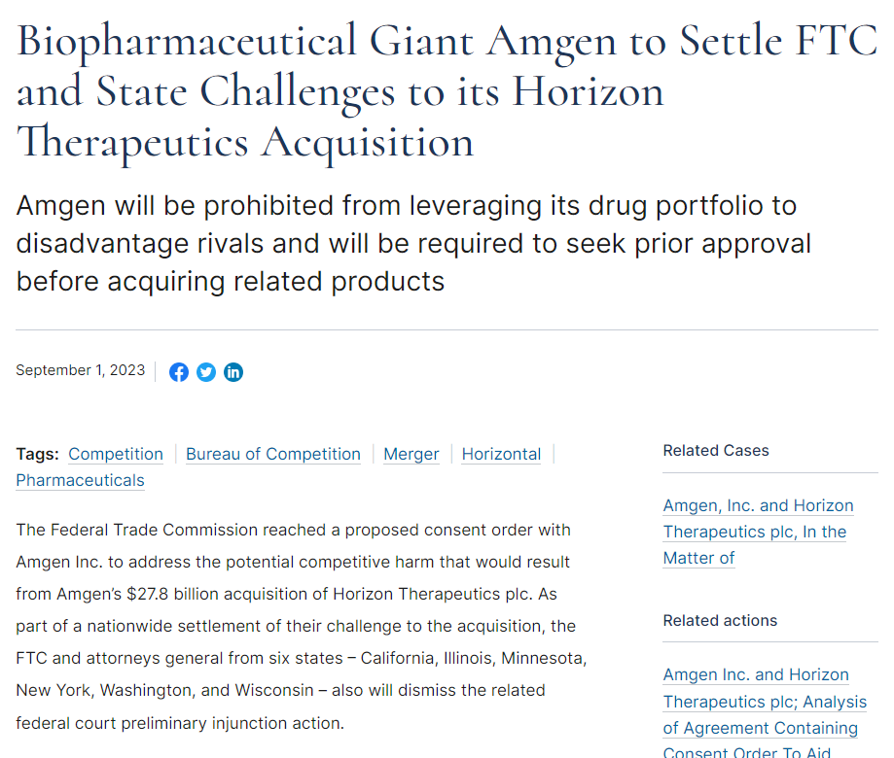
Pharmaceutical Merger Litigation (cont.)
After more than three months of litigation, the parties negotiated a consent agreement
Amgen agreed not to bundle any of its existing products with either of Horizon’s orphan drugs
Also agreed not to condition any rebate or contract terms on the sale or positioning of those drugs
Amgen must also submit annual compliance reports to the FTC and states, and agreed to submit to a monitor to oversee compliance
Interestingly, Amgen said all along that it had no intention of engaging in bundling, and that bundling would have been impossible in practice because Horizon’s drugs are administered in-office and therefore covered under medical benefits rather than pharmacy benefits

Slide 17
Agenda
Renewed Antitrust Focus on Healthcare
Expansion of Merger Guidelines
Antitrust Enforcement Developments
Horizon-Scanning

Slide 18
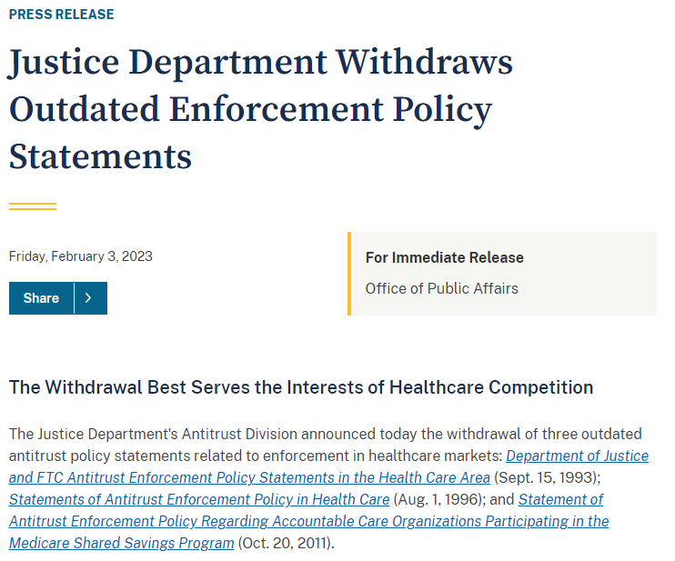
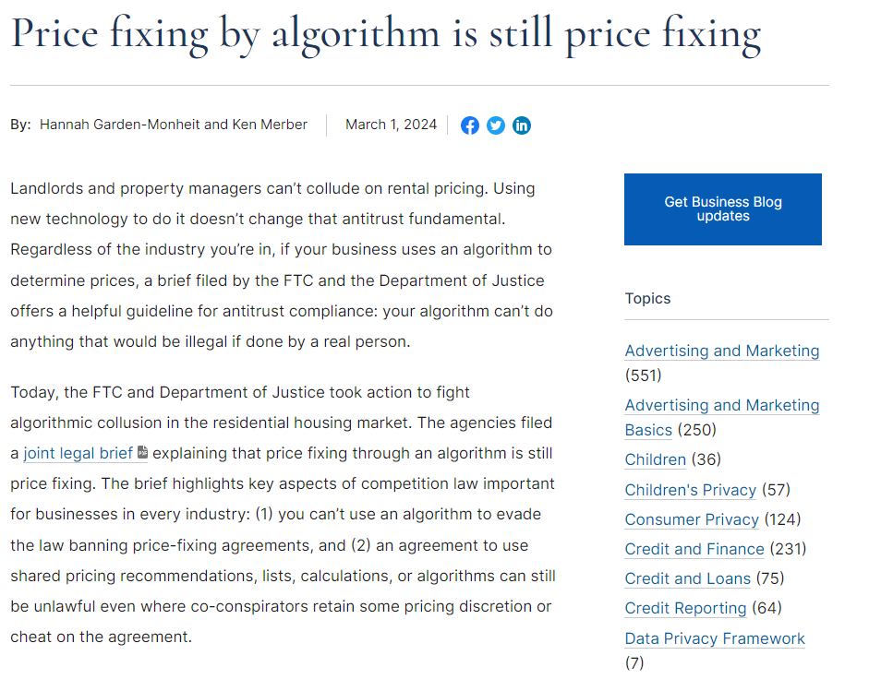
Focus on Information-Sharing
In 2023, the DOJ and FTC both withdrew from longstanding Statements of Antitrust Enforcement Policy in Health Care.
The day before DOJ’s withdrawal, the Principal Deputy Assistant AG for Antitrust gave a speech that cited concerns around “information-sharing,” especially given machine learning/AI.
In the wake of these withdrawals, the Agencies have been increasingly vocal about “algorithmic collusion”
DOJ has filed amicus briefs in support of private litigations about use of algorithms to set rents, hotel prices.
Expect increased focus on these issues in myriad contexts, e.g., wage and hour surveys; data intermediaries like GPOs/PBMs
Creates novel questions about compliance/training. E.g., how does an algorithm make an “agreement” with a competitor?

Slide 19
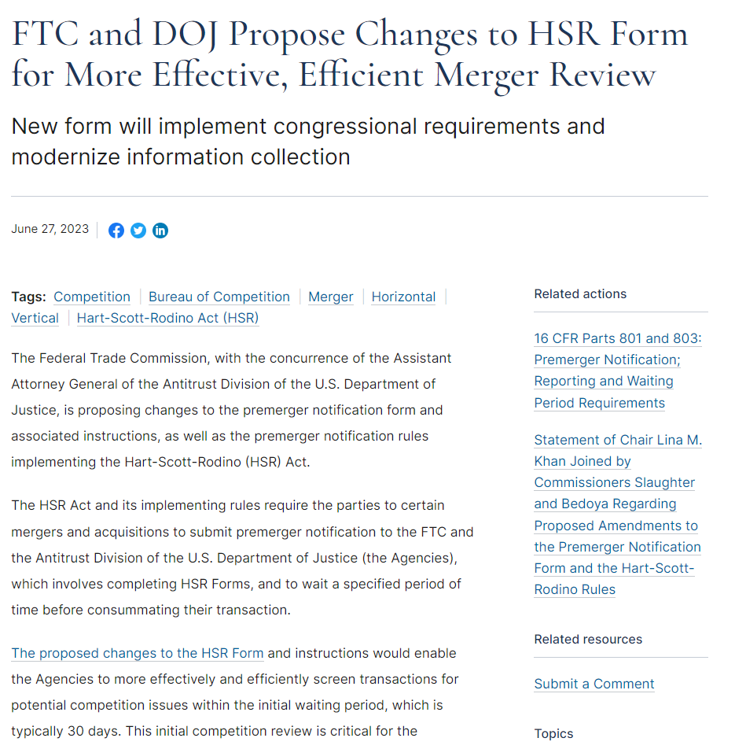
Proposed HSR Reforms
In June 2023, the FTC and DOJ proposed significant changes to the premerger review process (the Hart-Scott-Rodino Act rules)
FTC predicts a 4x increase in time/burden of preparing HSR filings, from 37 hours currently to 144 hours
Reforms are still in notice-and-comment period, may include:
Qualitative analysis of competitive effects
Expanded document search obligations, including some ordinary-course documents and iterative drafts
Information about employees and labor-law violations
Information about officers and board members
Information about IT systems; steps to preserve documents

Slide 20
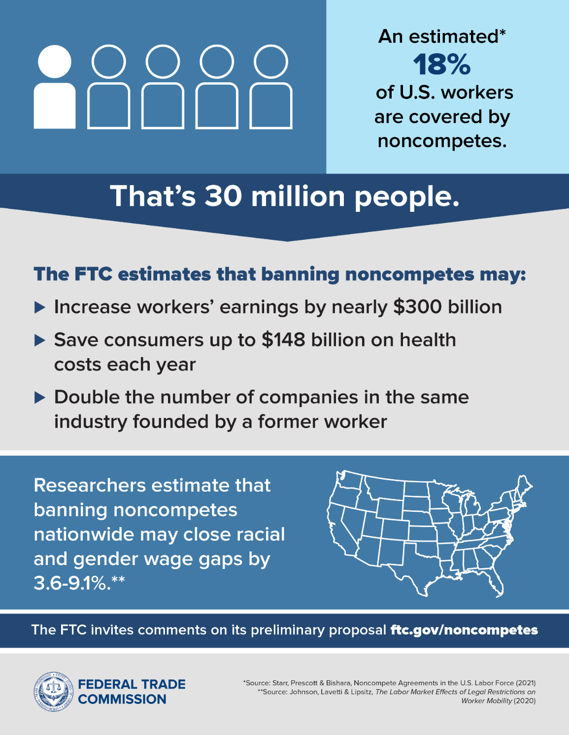
Potential Non-Compete Ban
In January 2023, the FTC proposed a federal regulation that would declare virtually all employee non-compete agreements to be an “unreasonable method of competition” in violation of the FTC Act.
Released a 216-page notice of proposed rulemaking, surveying the academic literature on the competitive effects of non-competes
Preliminarily found that non-competes suppress wages, both for workers who are subject to them and for workers who are not
Also preliminarily found that non-competes raise consumer prices, increase market concentration, and discourage entry by new competitors

Slide 21
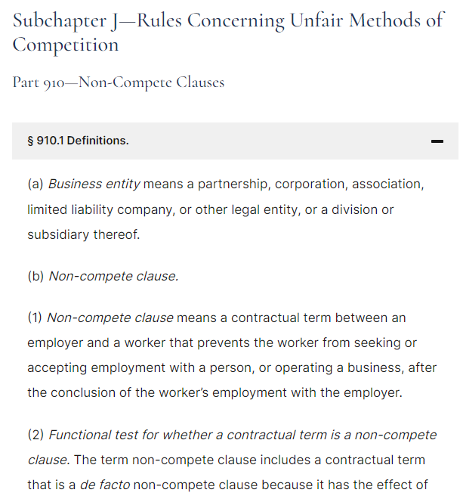
The Proposed Non-Compete Rule
As proposed, the Non-Compete Rule would:
Declare it an “unfair method of competition” to enter into, attempt to enter into, or maintain a non-compete agreement with a worker
Adopt a “functional test” to define non-compete agreements
Require businesses to rescind any pre-existing non-compete agreements and notify current and former employees of this rescission
Pre-empt/supersede state laws that allow non-competes
Recognize a limited exception for the sale of a business, but only where the employee was a 25%+ owner
Allow a 180-day period for implementation, to begin upon the date the final rule is announced

Slide 22
Can the FTC Do This?
The FTC’s position:
By statute, the FTC is empowered to “make rules and regulations”
In 1973, a federal appellate court held that this power allows the FTC to adopt “binding substantive rules”
The FTC recognizes there are some limits to its authority under the FTC Act, but the contours of these limits are unsettled
Banks, credit unions, S&Ls
Common carriers
Non-profits (at least sometimes)
Objections will include:
The same 1973 opinion also said that FTC is “hardly free to write its own law of consumer protection and antitrust”
Since that decision, Congress has narrowed the FTC’s rulemaking powers even further
“Major Questions” doctrine
Federalism vs. states’ rights
Fifth Amendment Takings / Due Process concerns about retroactivity
“Non-delegation” doctrine

